Slide 1
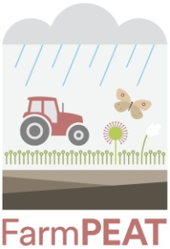
Raised bogs of Ireland
A look at the history of Irish Raised bogs and their importance in the current climate crisis.
Alena Kunkel, M.A. FarmPEAT
www.farmpeat.ie
March 2023

Slide 2
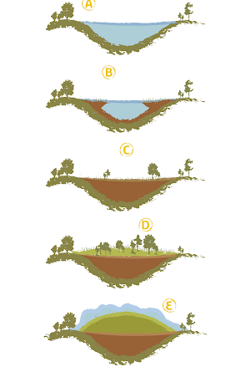
What are bogs and how are they formed?
Mostly known as sources of peat
Mostly found in the midlands.
Began forming 10,000 years ago.
Started as shallow lakes.
Plants died and gathered at the bottom of the lake where the conditions were anaerobic, meaning the plants didn’t break down fully.
Dead plants built up over time and began to form peat, this eventually reached the surface.
Sedges began to grow turning it into a fen.
Raised bog species (e.g. sphagnum moss) invaded and the fen became a raised bog.

Slide 3
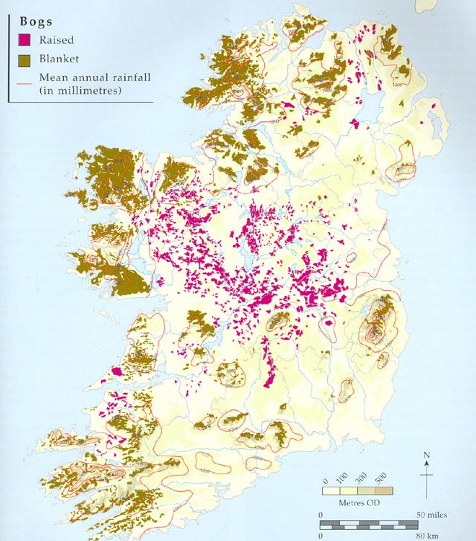
Where are they found?

Slide 4
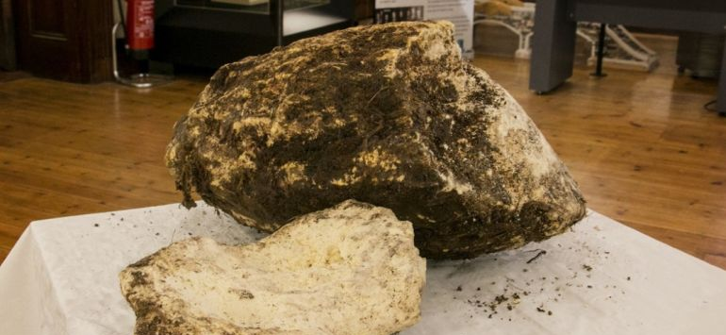
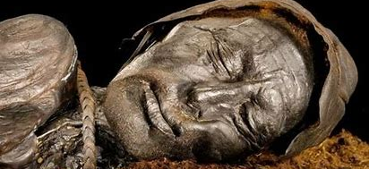
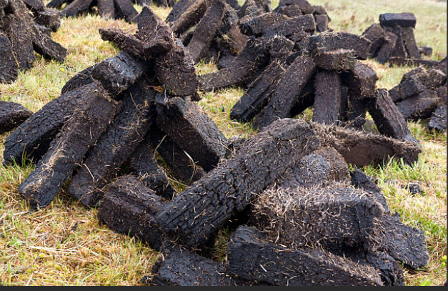
History of the bogs
Before bogs were ever used as sources as fuel, they were also used as storage for items such as butter!
….and bodies!
Environmental benefits aside, bogs are mainly used as a fuel source i.e. peat harvesting
Began in the 1800s.
Provided jobs and built up communities in rural areas
Some areas reclaimed for agricultural purposes

Slide 5
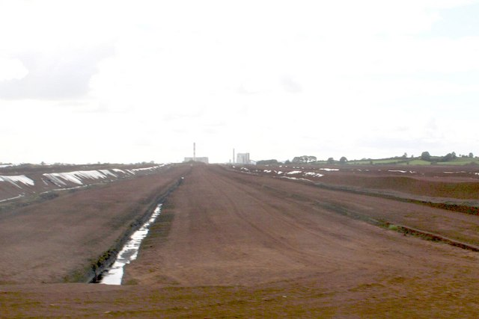
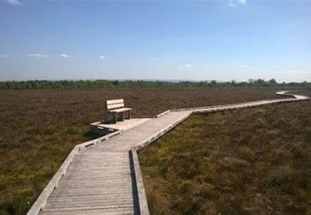
Bogs today
Bord na mona have stopped turf cutting on their bogs.
Still being cut by other individuals
Very damaged from years of draining
No fully intact remaining bogs
Different projects looking at restoring the bogs
Also being used as tourist attractions, outdoor wellness

Slide 6
Why are they important?
What ecosystem services do they provide?

Slide 7
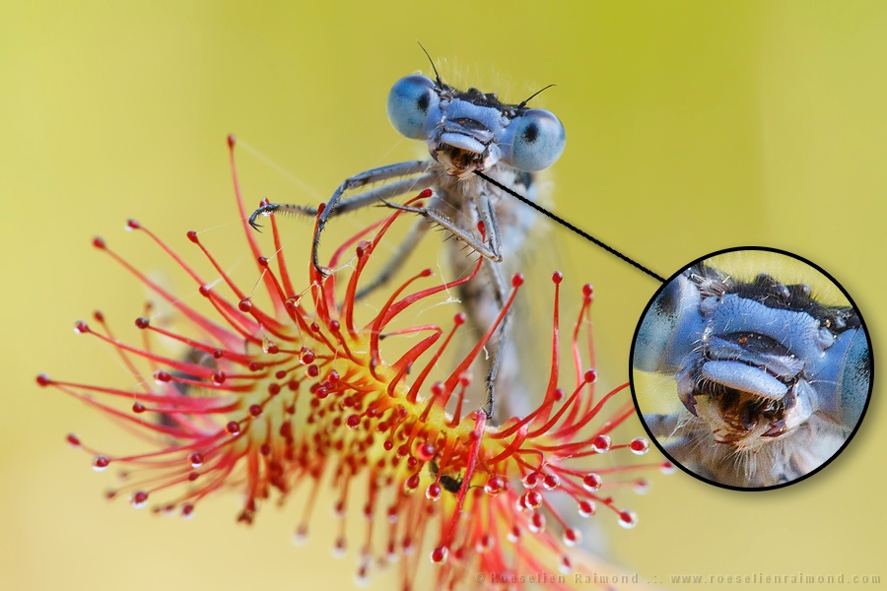
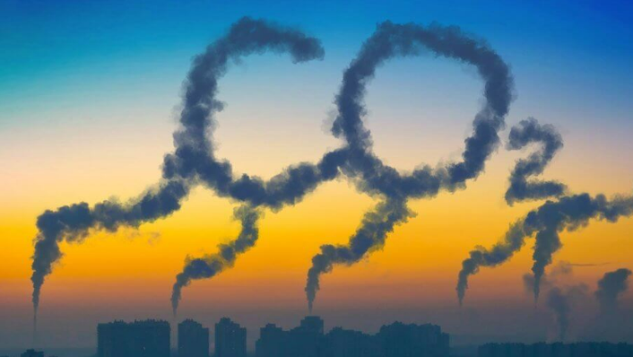
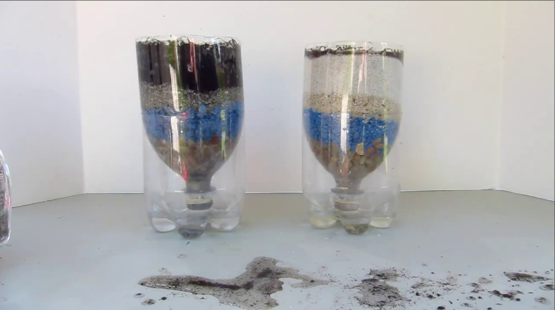
Why are they important?
What ecosystem services do they provide?
Water – filtration systems
Biodiversity
Carbon sequestration
Outdoor amenities/tourist attractions

Slide 8
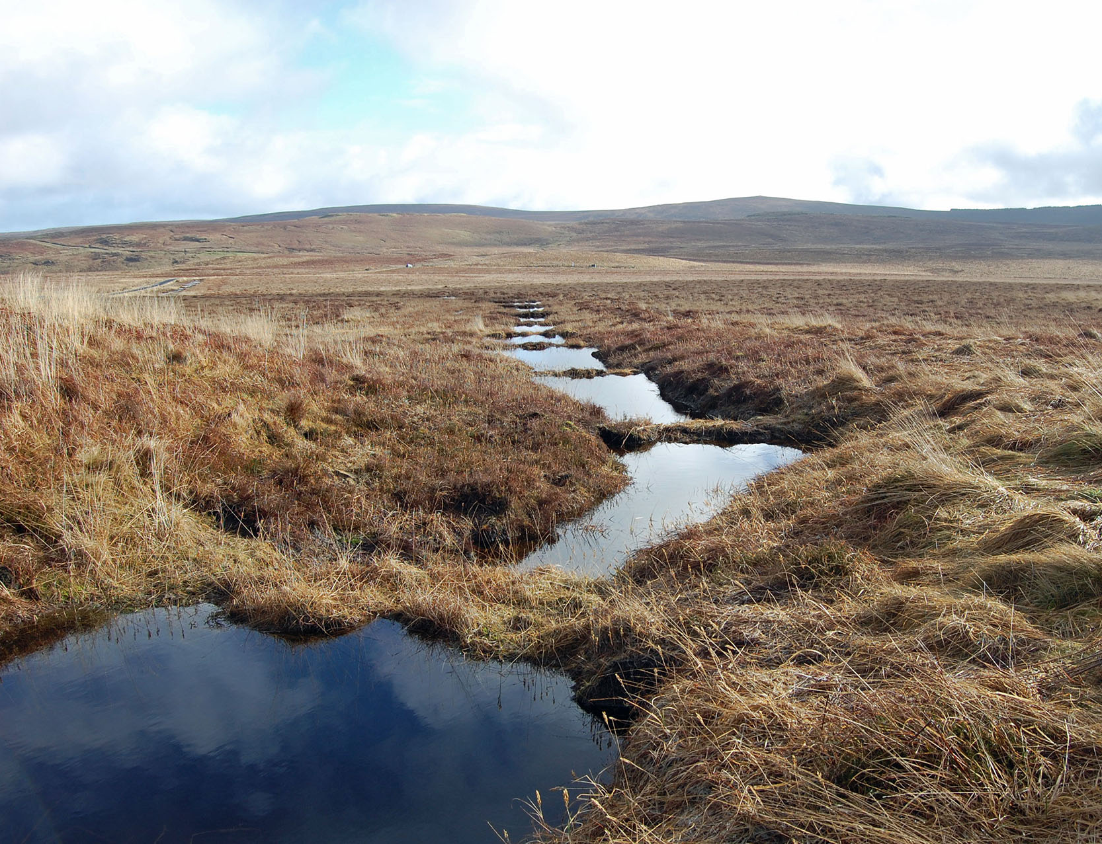
Water
Bogs are rain-fed.
When they are in good consition they can hold a vast amount of water.
Raised bogs are made up of 90% water.
They store this water and release it very very slowly, acting as a filtration system.
Peat Bog Restoration Project Garron Plateau - YouTube

Slide 9
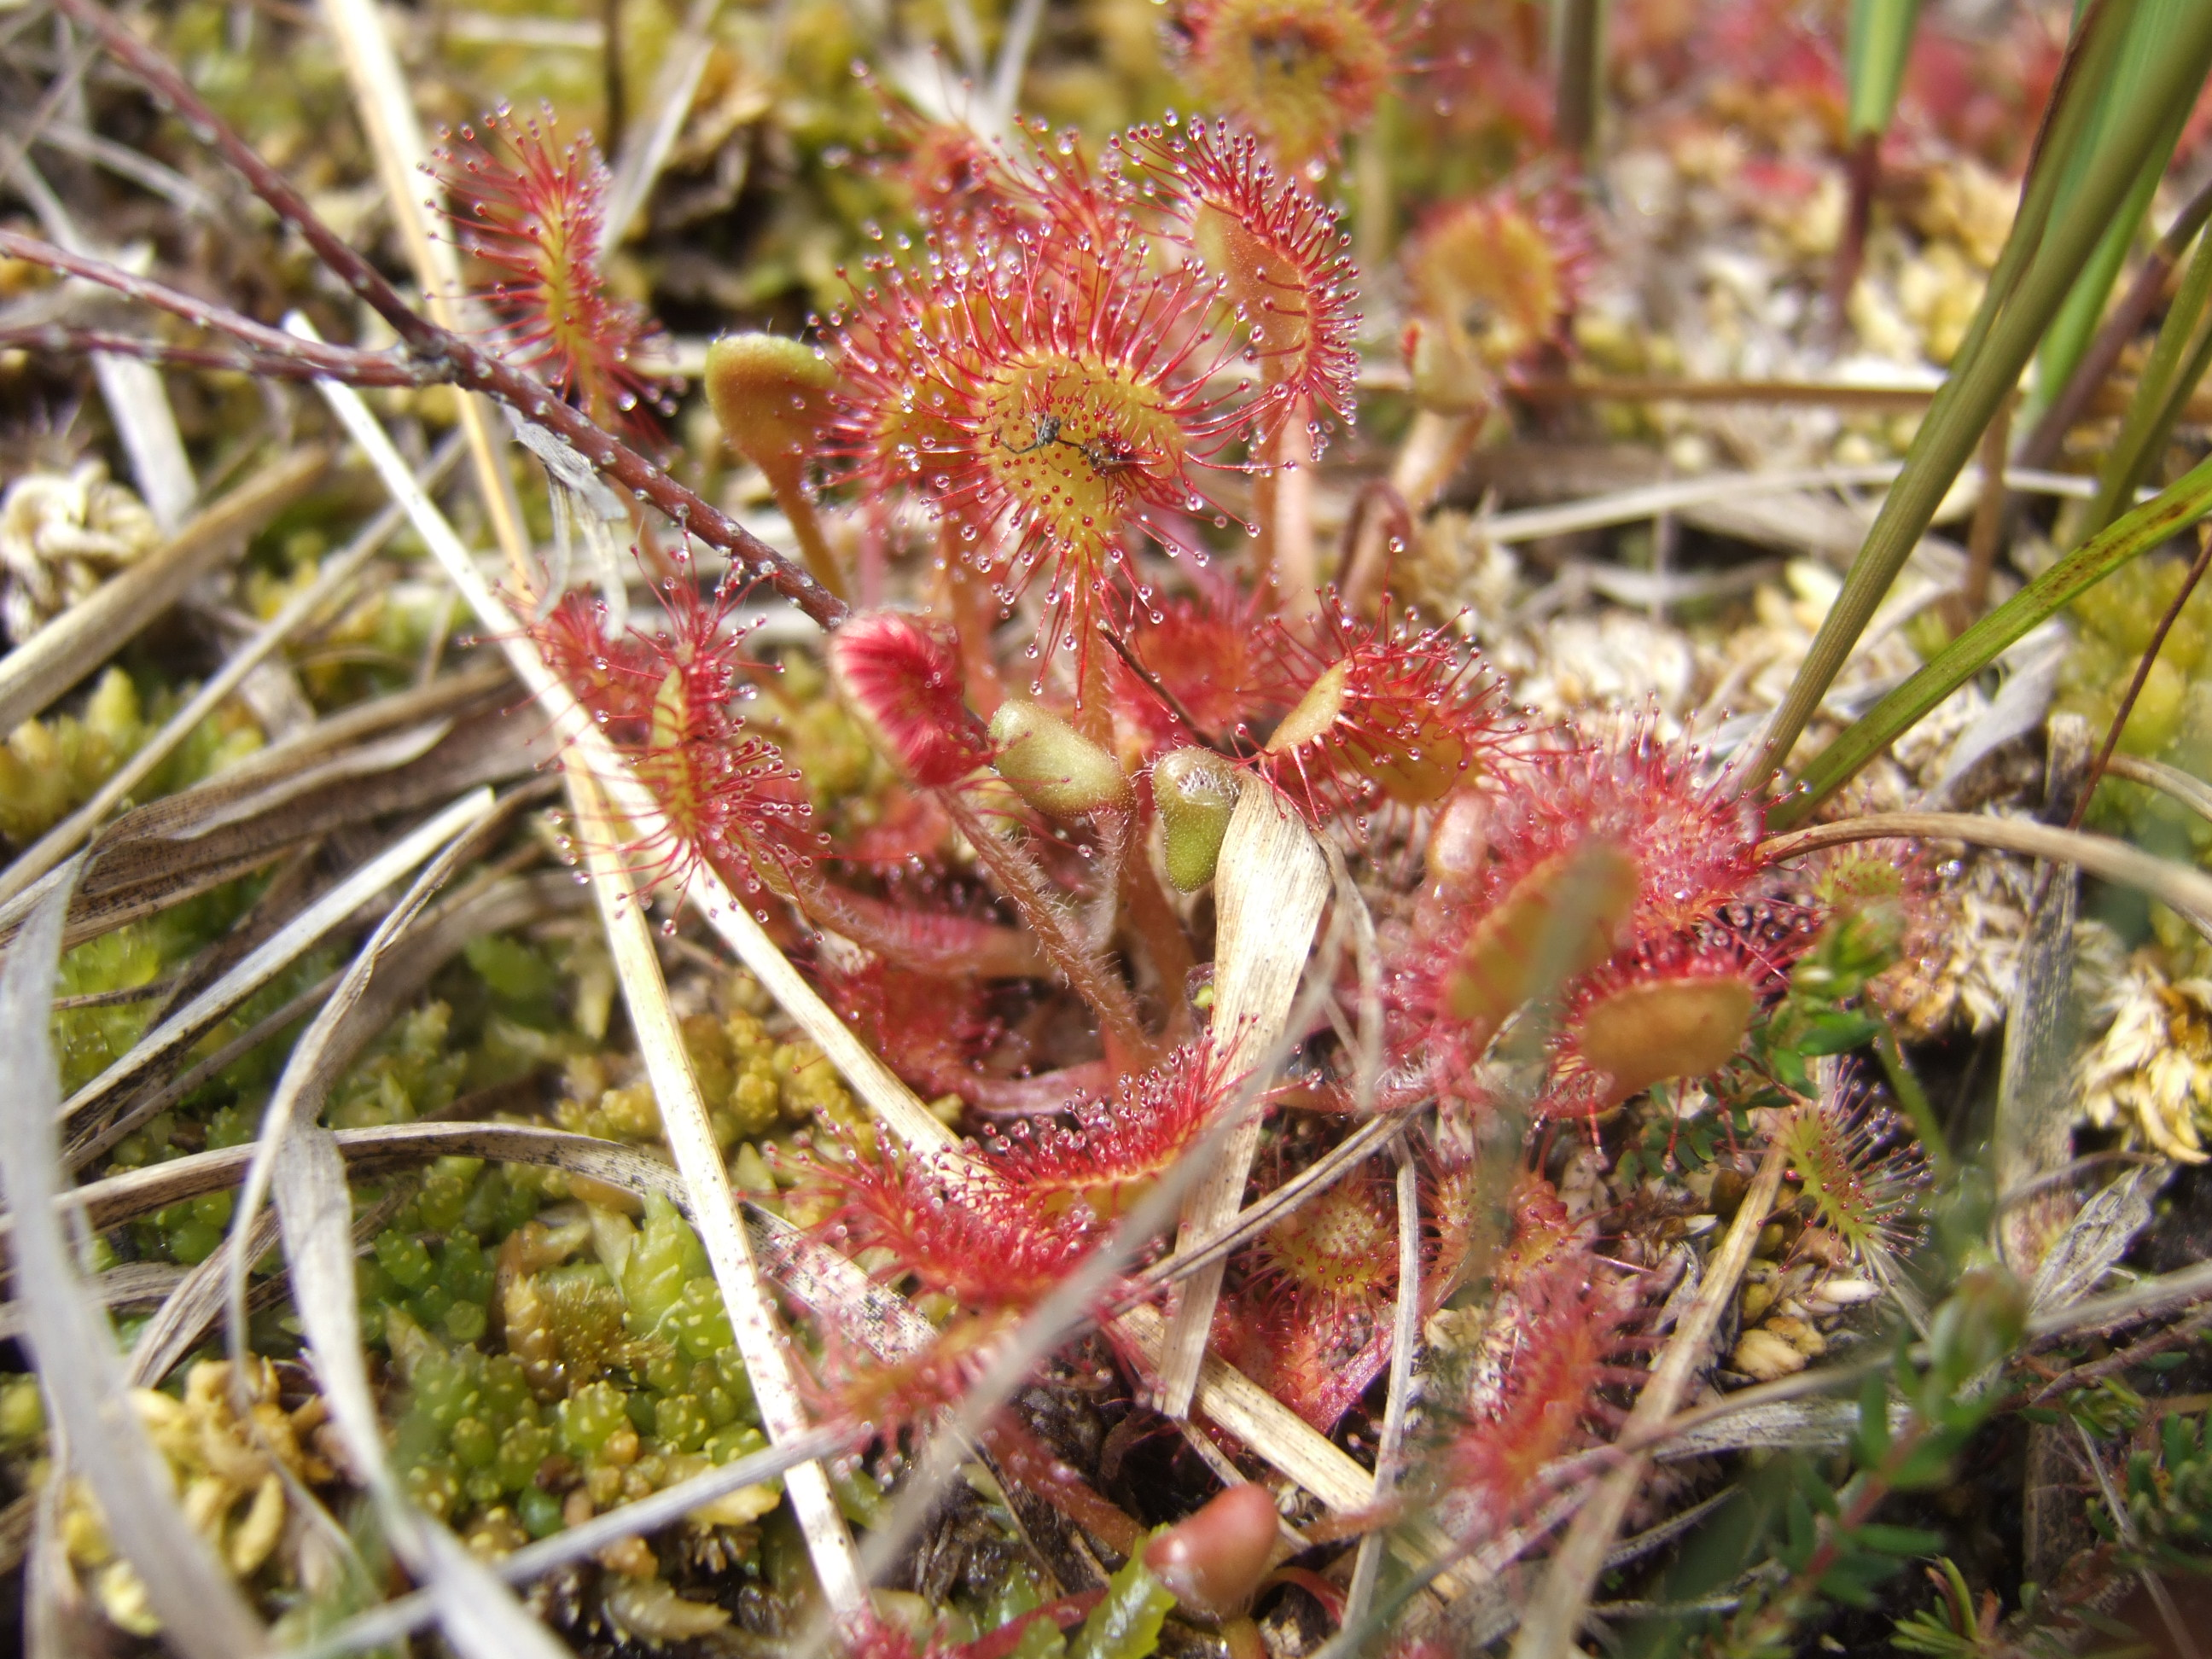
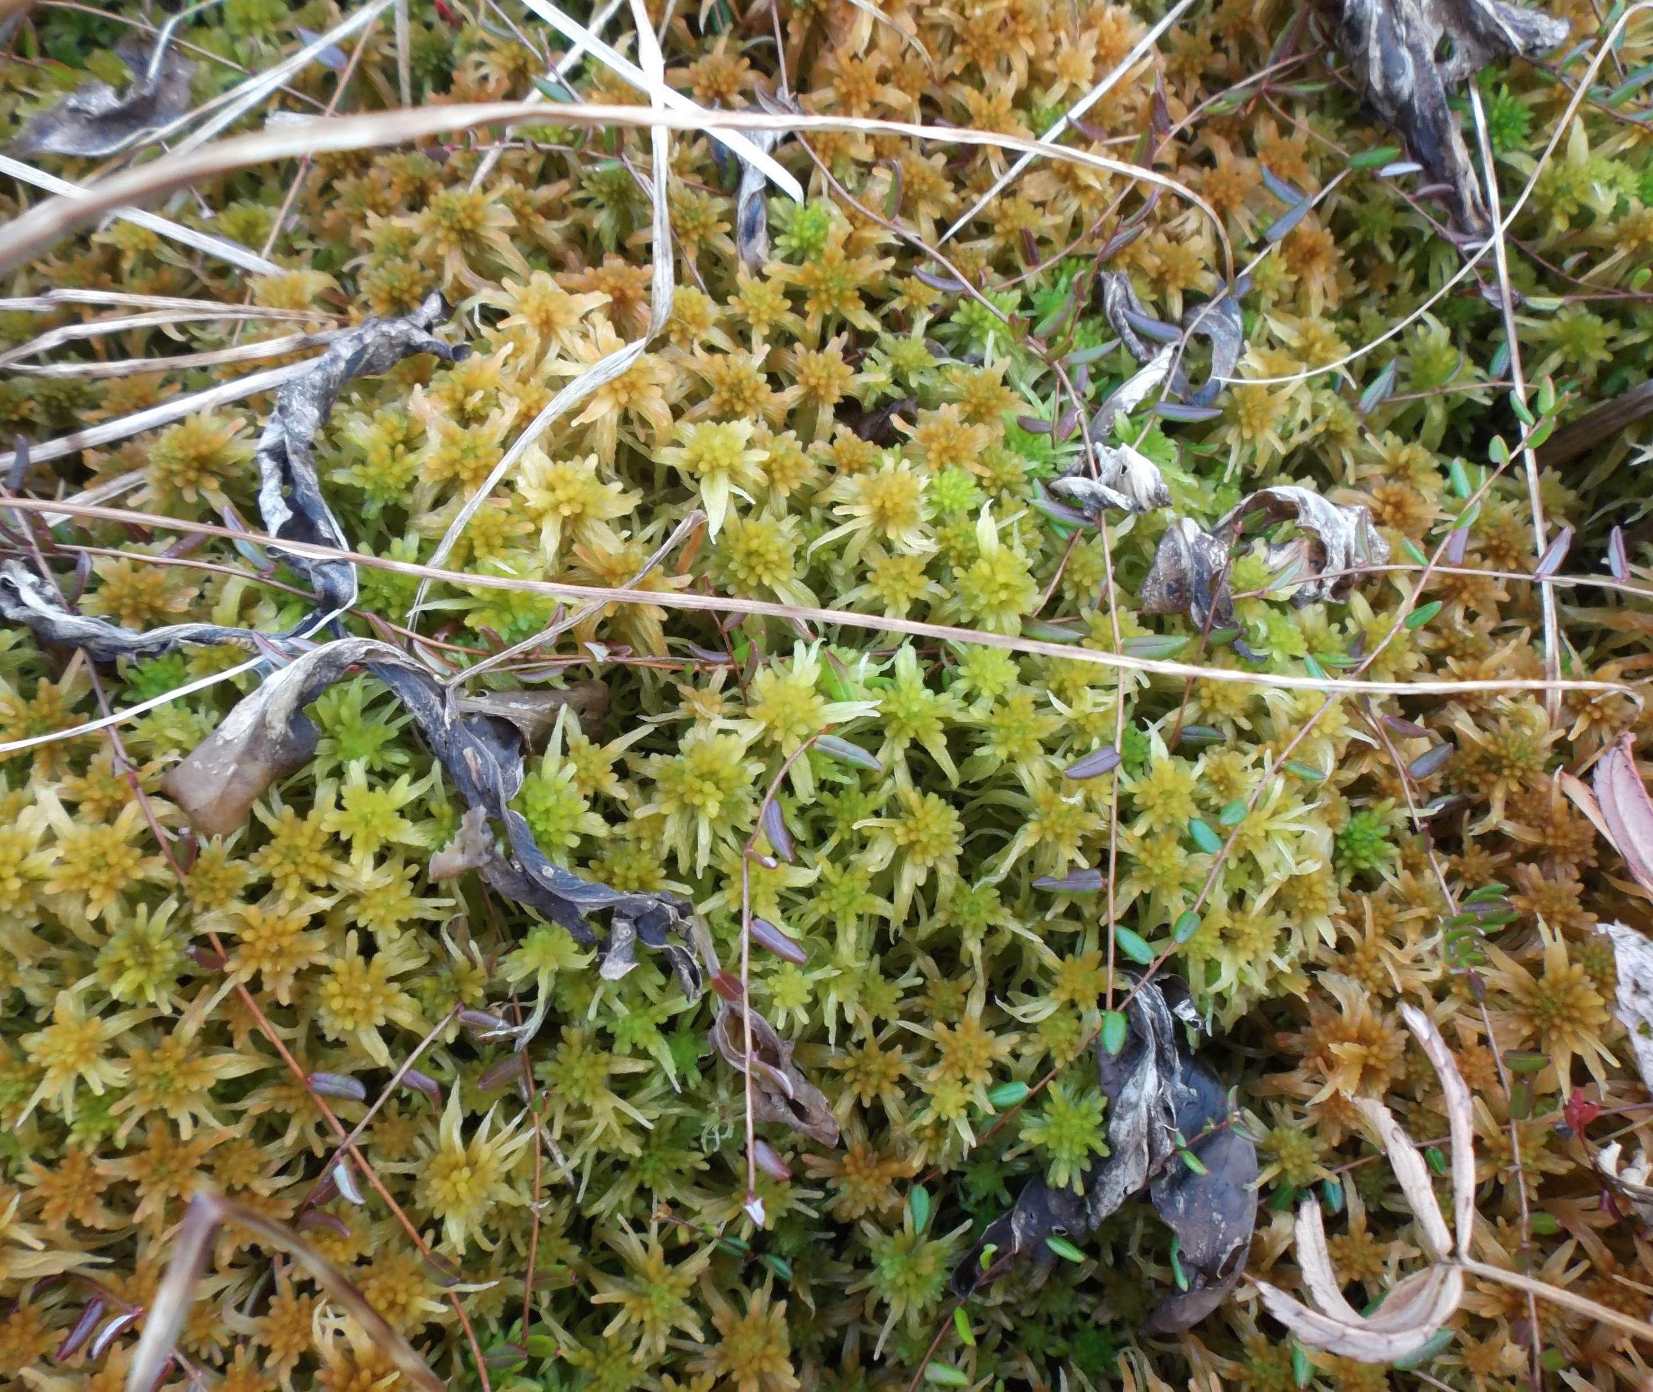
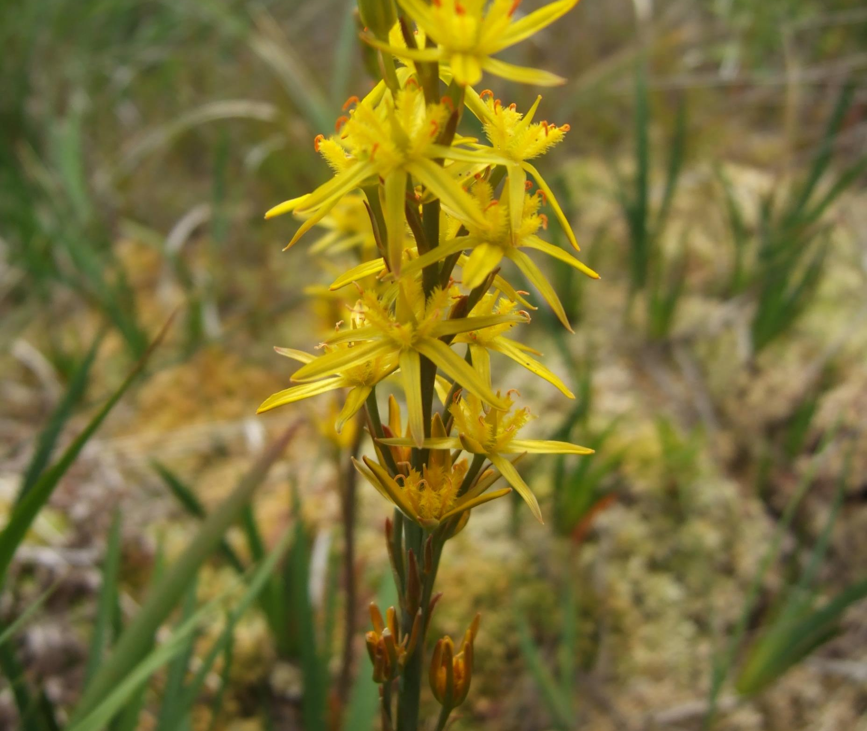
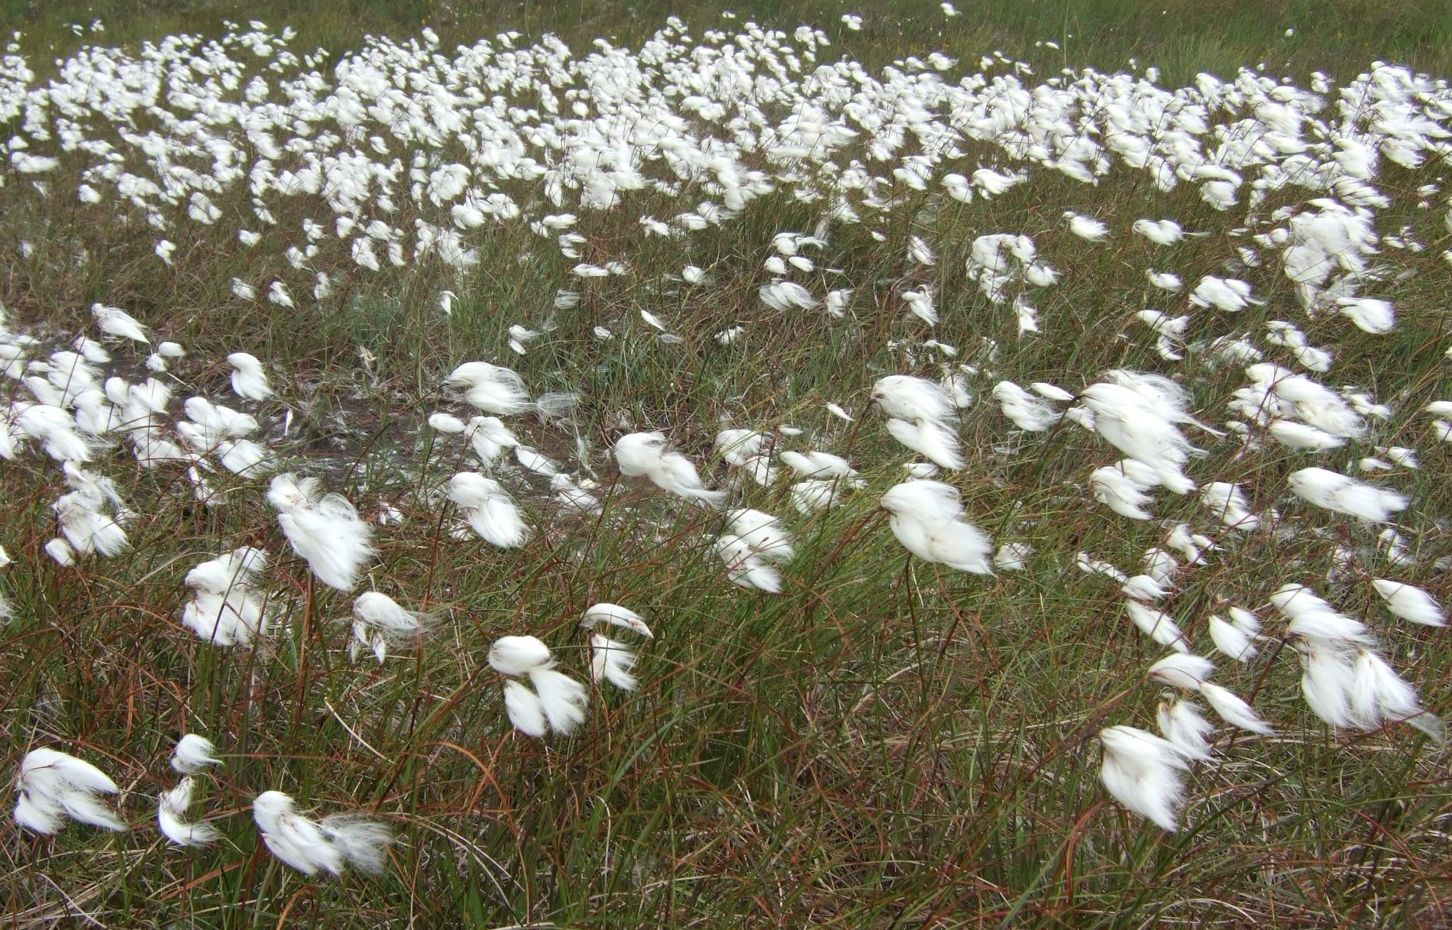
Biodiversity
Bogs are home to many unique flora and fauna

Slide 10
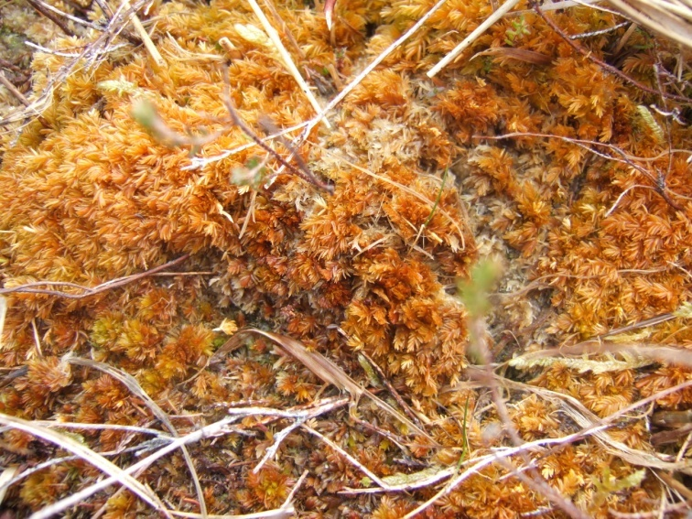
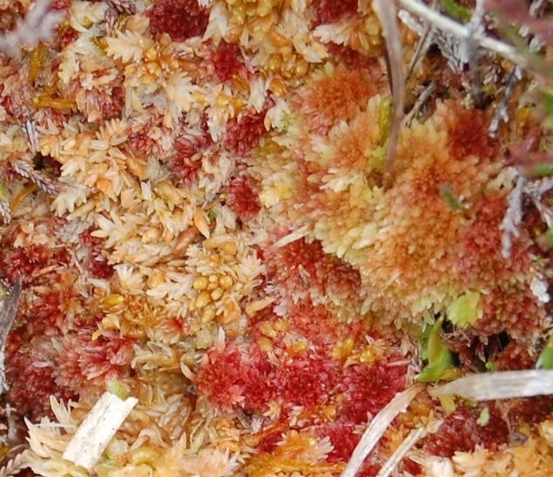
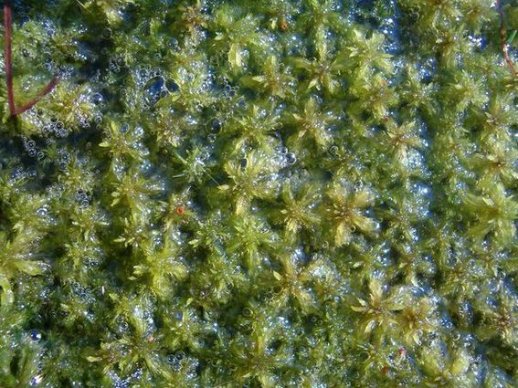
Sphagnum moss – the bog builder
Absorb nutrients from surrounding water
Can hold 20 times their own weight in water

Slide 11
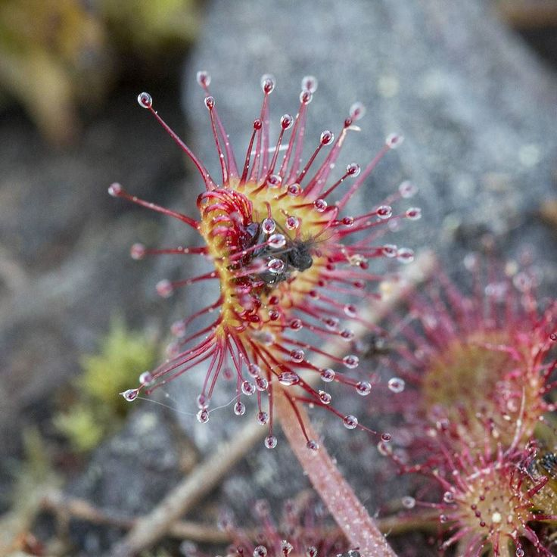
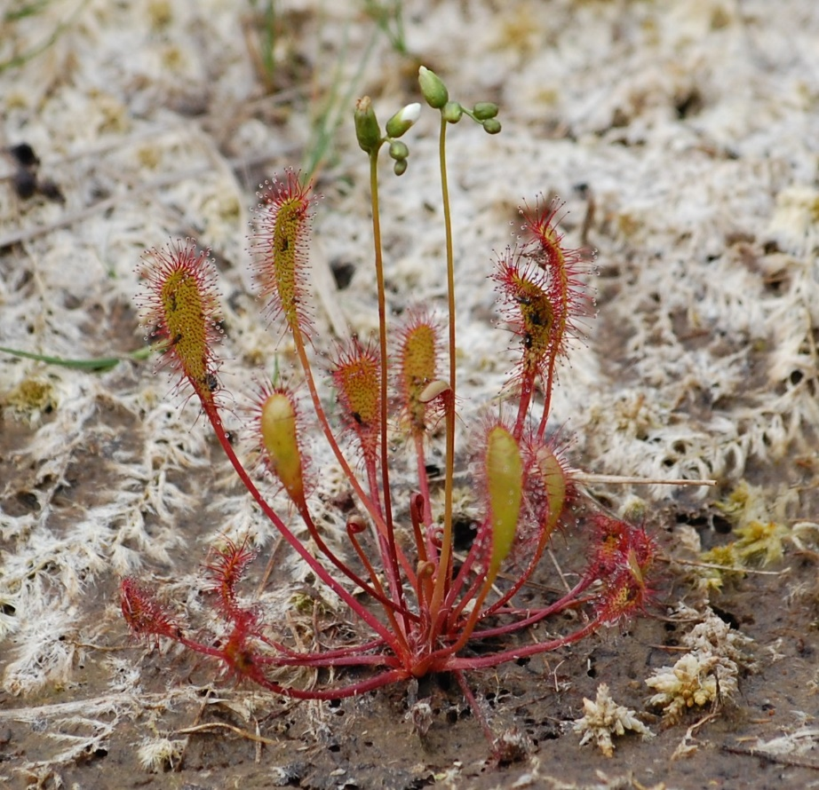
Sundew – a native carnivorous plant
Sundews have a sticky shiny surface that attracts insects
They can trap the insect with their leaves and eat them!
Cape Sundews Trap Bugs In A Sticky Situation | Deep Look - YouTube

Slide 12
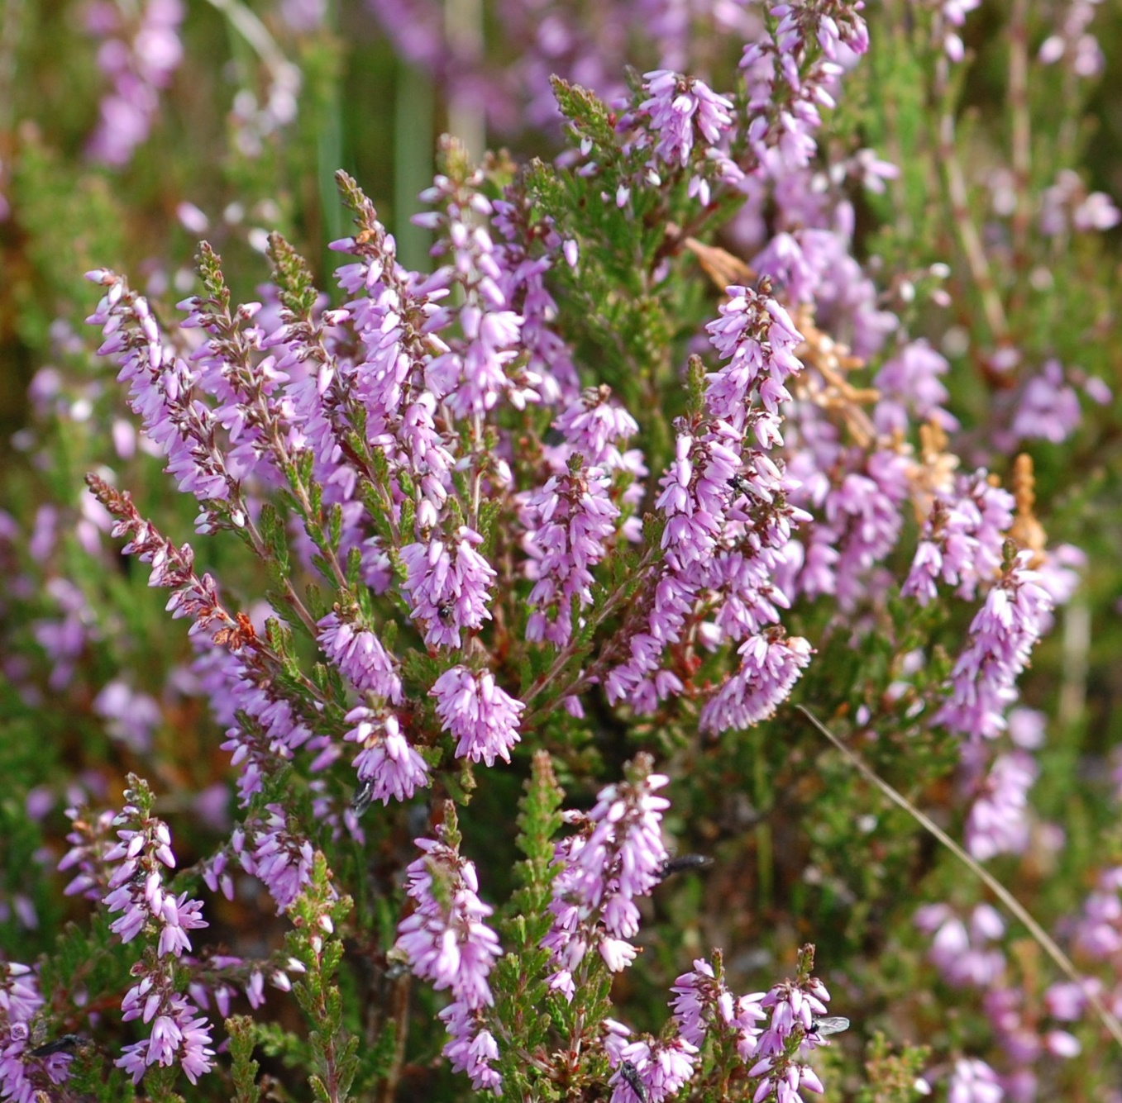
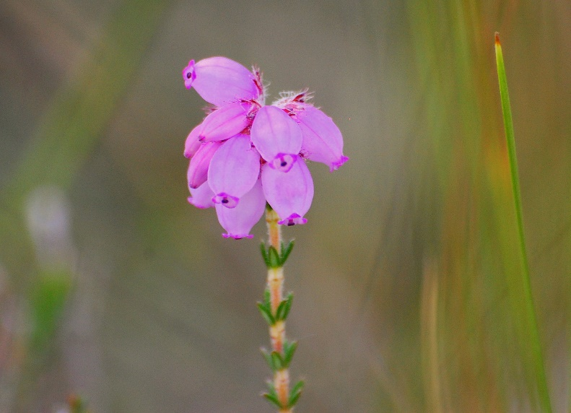
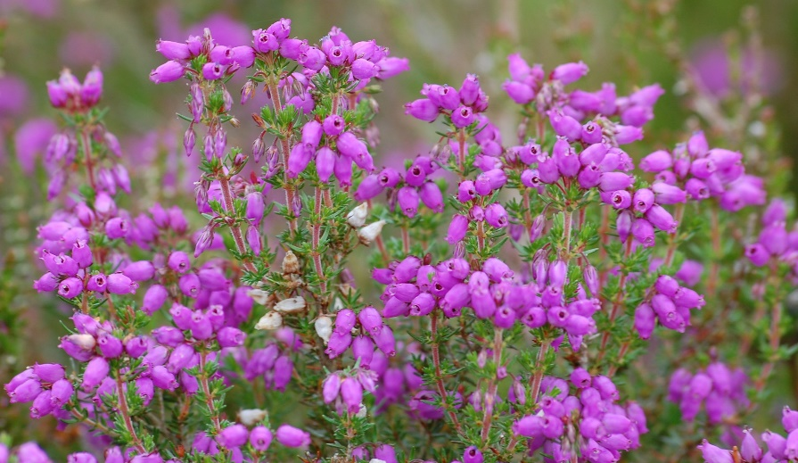
Ling Fraoch mór
Cross-leaved Heath Fraoch naoscaí
Heather Fraoch
Bell Heather Fraoch fireann

Slide 13
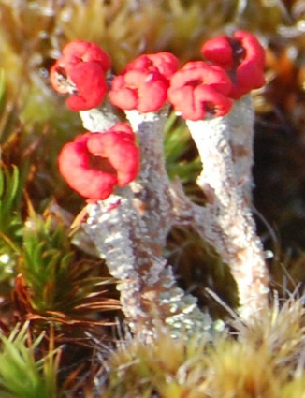
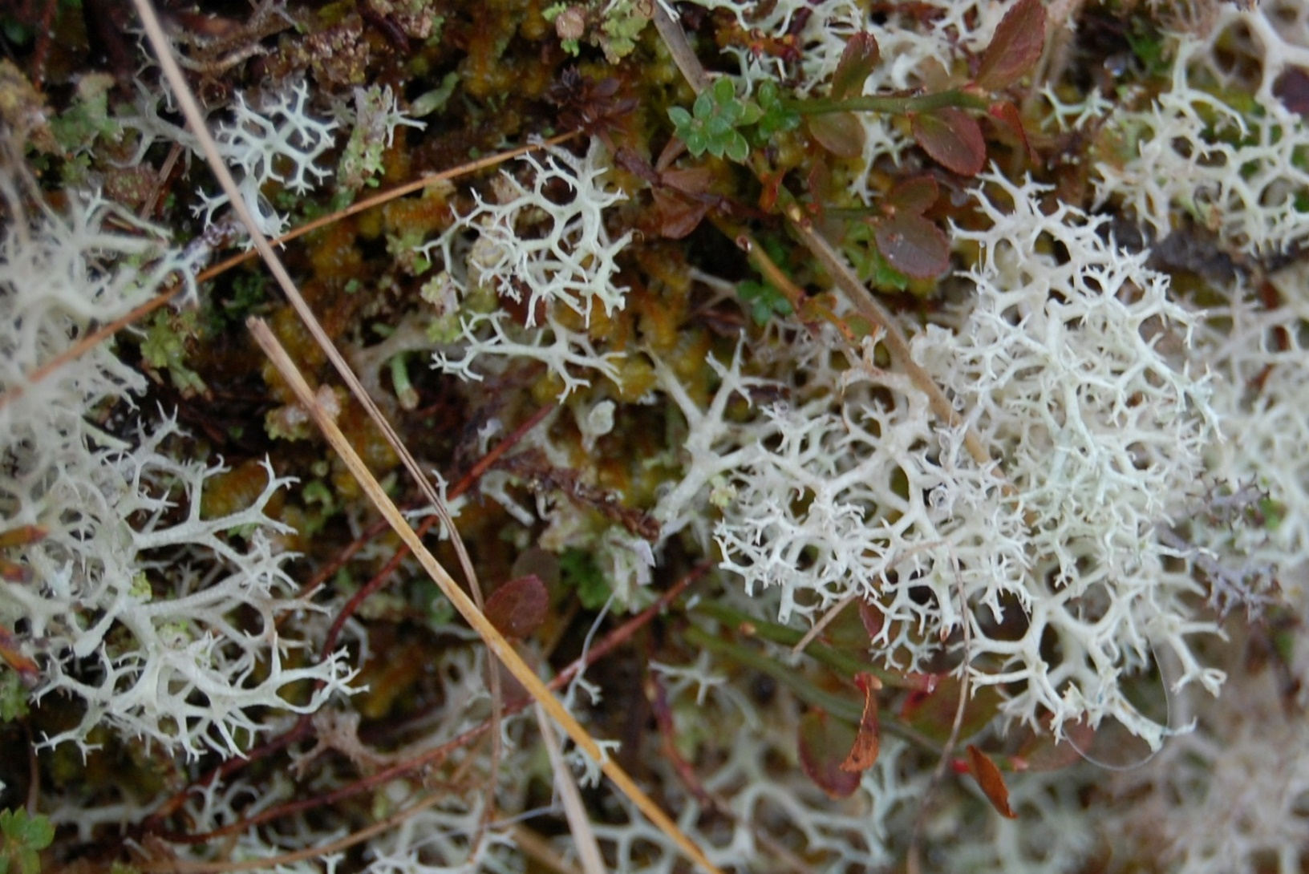
Lichens
Matchstick Lichen
Reindeer Lichen

Slide 14
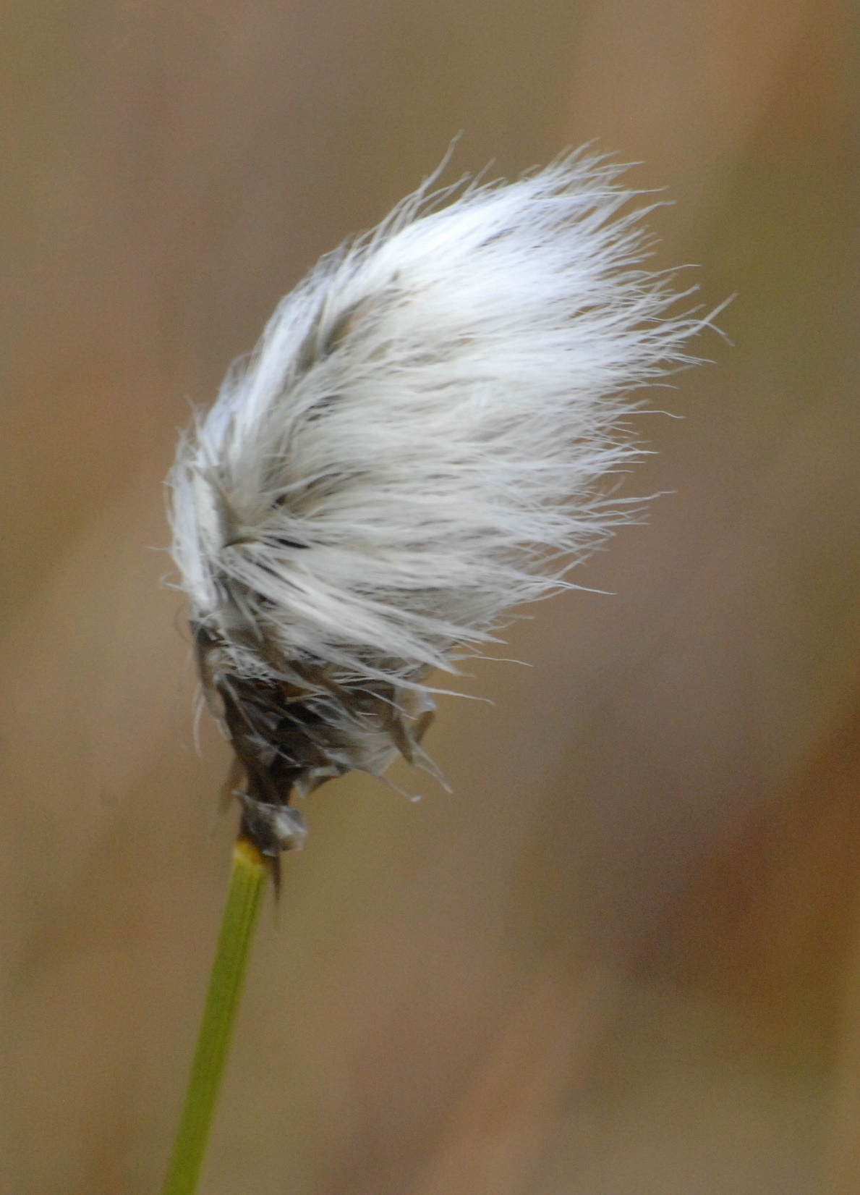
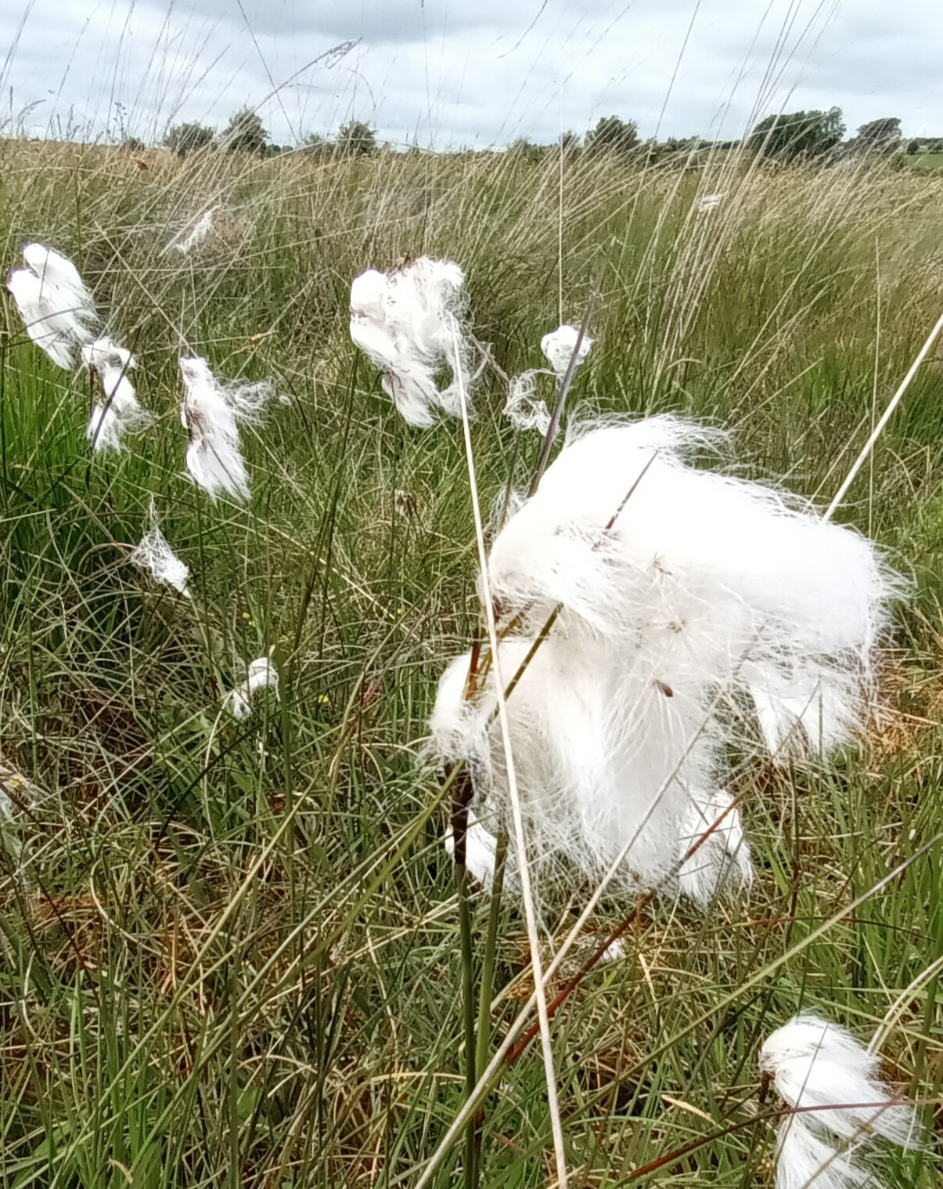
Bog Cotton

Slide 15
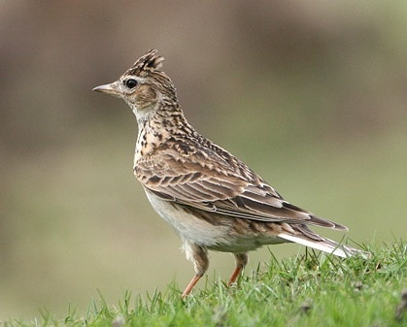
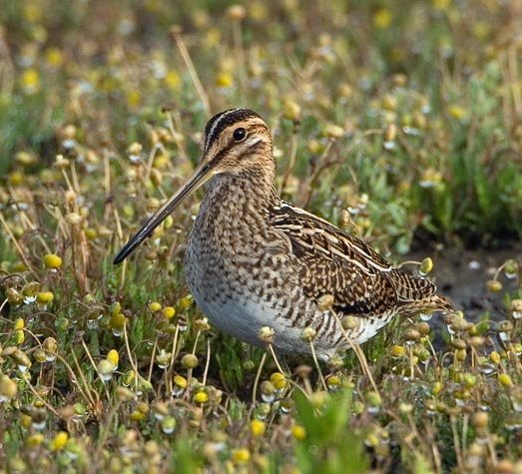
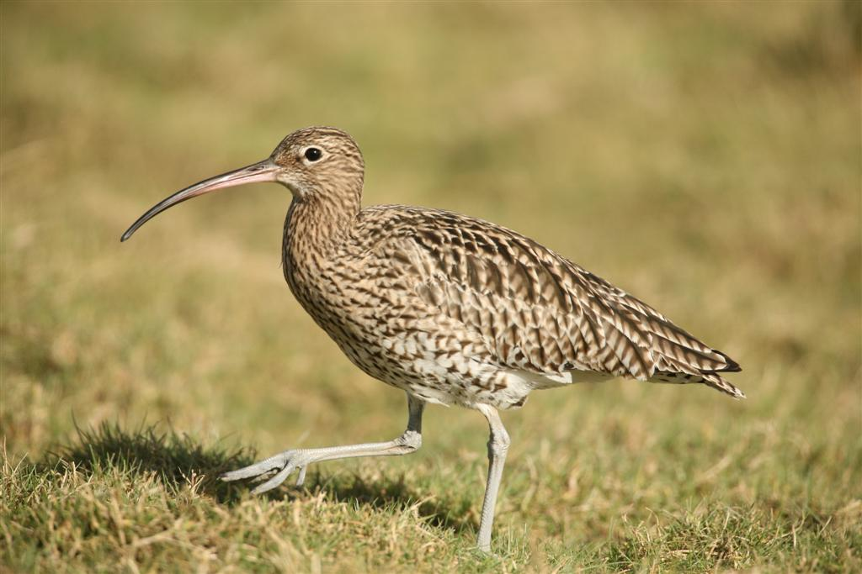
Birds of the bog
Skylark Snipe Curlew
https://www.youtube.com/watch?v=Ws7jH6wNKN4

Slide 16
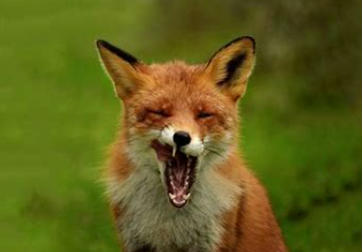
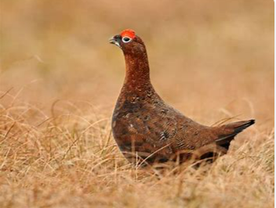
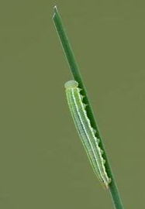
How are these different plants and animals connected?

Slide 17
Carbon stores
Carbon is a gas that comes from cars, burning fossil fuels, farming etc.
It is one of the things causing climate change
Can you name something that stores carbon?
Bogs have a special ability to hold this carbon and keep it underground
Under one condition: they need to be wet!
If we dry out our bogs, they can no longer hold this carbon and it goes up into the air instead

Slide 18
Carbon storage in the Amazon rainforest…

Slide 19
…versus carbon storage in peat soils

Slide 21
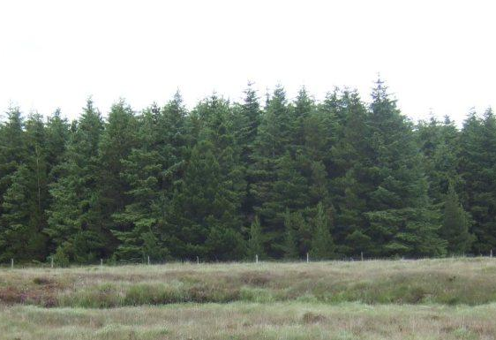
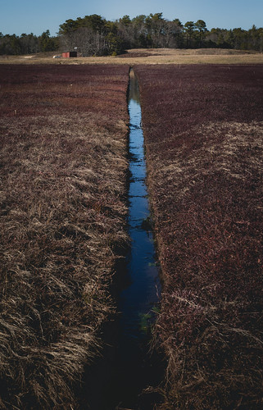
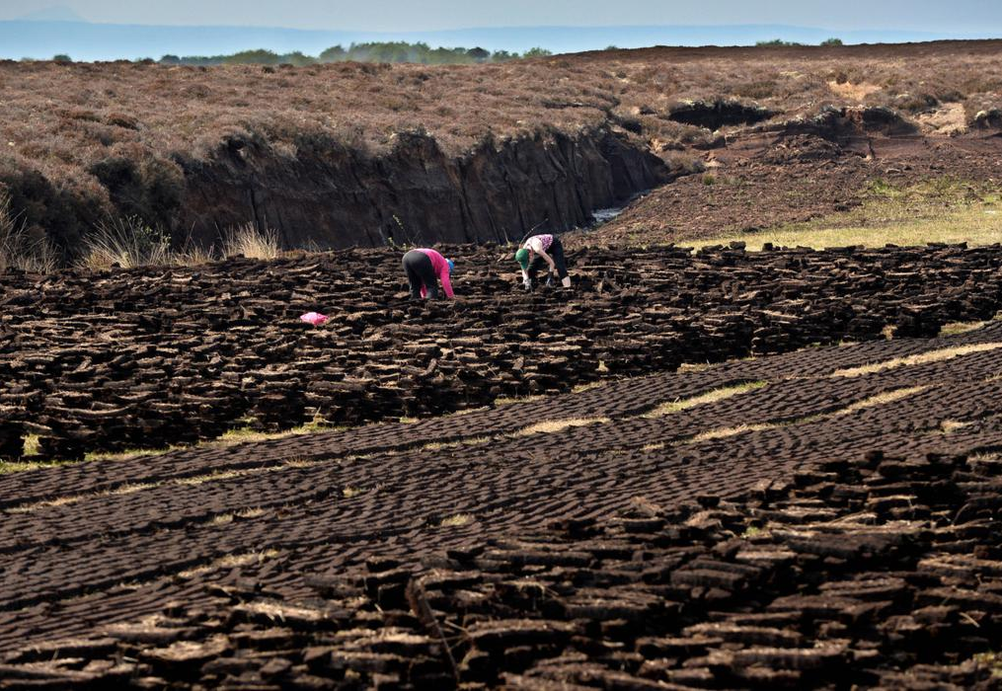
From a sink to a source
CARBON

Slide 22
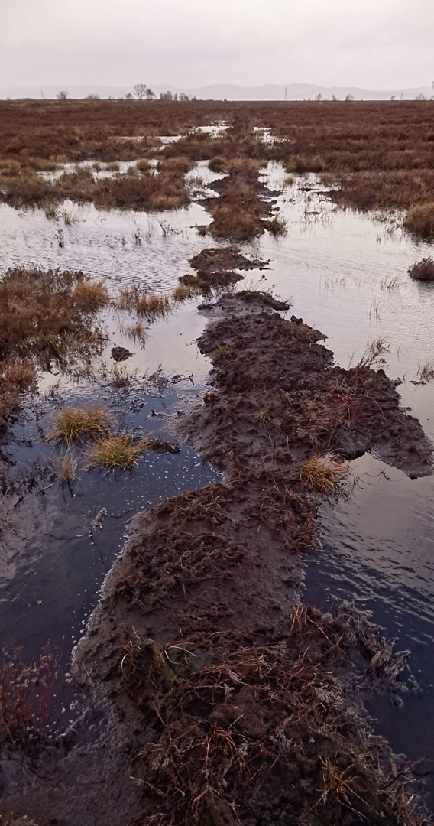
Restoration and rewetting peatlands
It is believed that if we rewet our bogs, it will help reduce our GHG emissions and enhance biodiversity.
Different projects working to restore our bogs
E.g. Care peat, The Living Bog, FarmPEAT, Bord na Mona
Common aim is to rewet the bogs
Raising the water table
Peat soil becomes wet again and can rejuvenate and stop being carbon sources/reduce emissions
Chapter 2 - Threats to the Bog and Project Actions - YouTube

