Slide 1
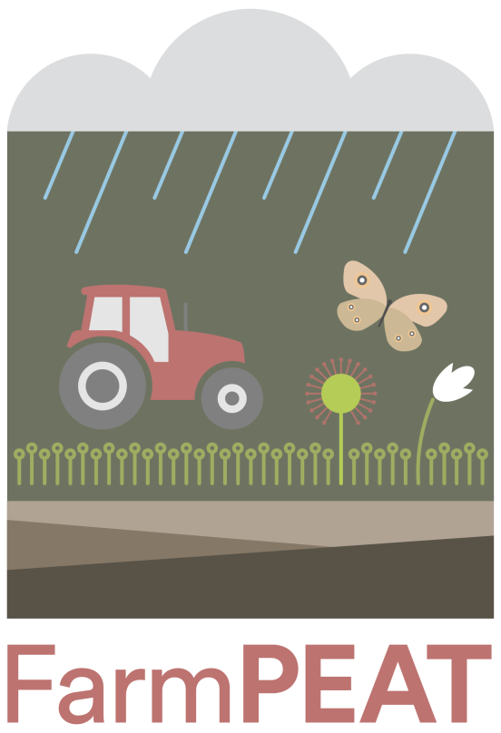
Farm Payments for Ecology and Agricultural Transitions
FarmPEAT Project Farmer Training Day
September 2022

Slide 2
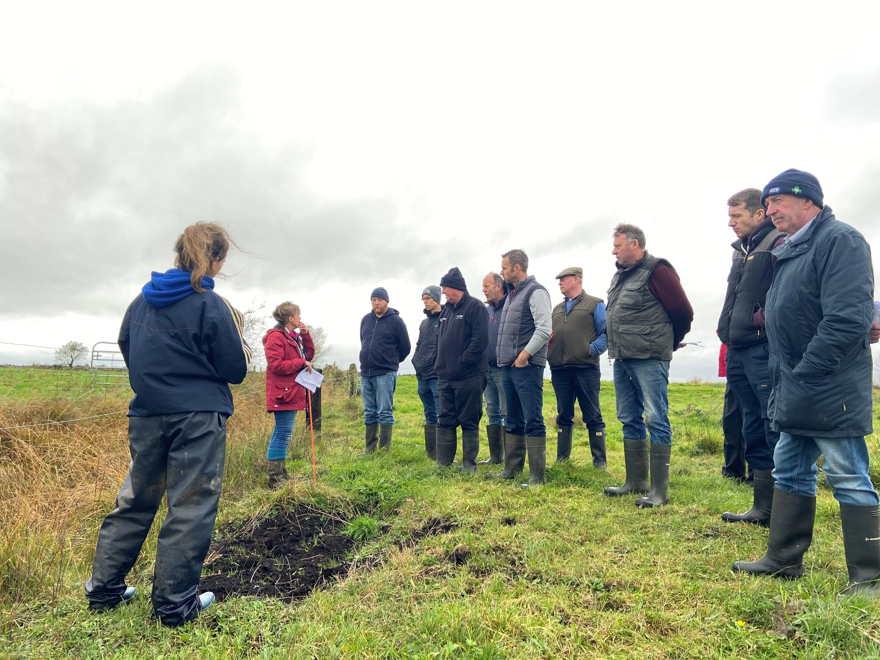
Training Day Agenda
10am – 2pm
Indoor session (1.5 hours)
Welcome
Introduction
Questionnaire
Outdoor session (1.5 hours)
Farm visit
Run through how the score card is used

Slide 3
Project Background and aims
European Innovation Partnership (EIP)
Funded by DAFM through the Rural Development Programme (€1.2 million)
Two year programme will run from April 2021 – April 2023
Partnership between Wetland Surveys Ireland, Irish Rural Link and Umeras Community Development
Local project team working in partnership with farmers to develop the programme
Aim to work with farmers to design and trial a locally adapted result-based scheme for the Irish Midland Landscape
Manage habitats on peat soils, benefitting climate, biodiversity and water
Reward farmers for maintaining and improving the local environment

Slide 4
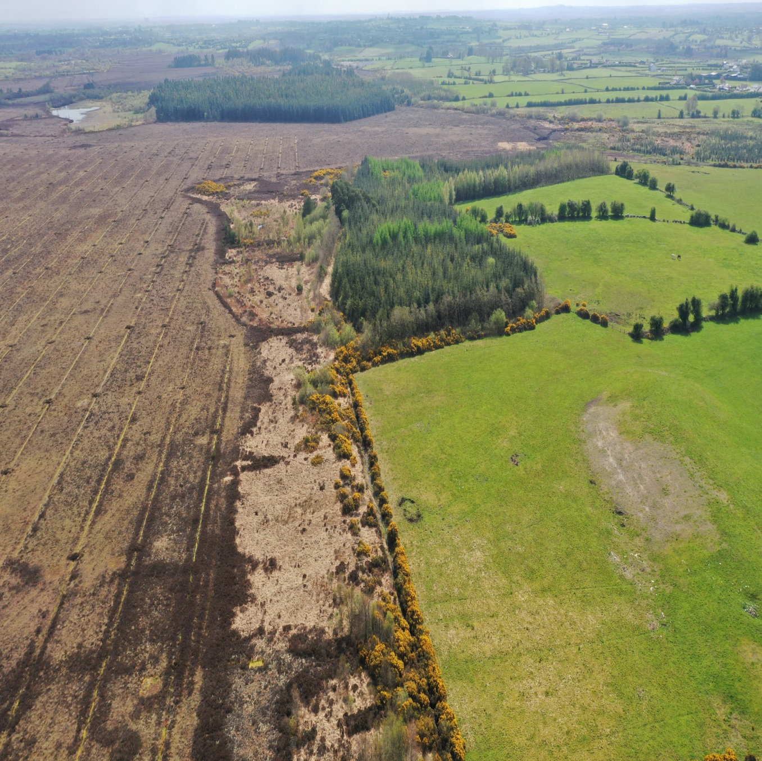
Aims of project
Aim to work with farmers to design and trial a locally adapted result-based scheme for the Irish Midland Landscape
Manage habitats on peat soils, benefitting climate, biodiversity and water
Reward farmers for maintaining and improving the local environment
Currently, the DAFM have a target to rewet 80,000 ha of grasslands on peat soil.
This project can be seen as a stepping stone in preparing farmers for this target.

Slide 5
Pilot Project
Project will run for 2 years, over 8 different sites.
The purpose of a pilot project is to gather information on how to best manage peat soils in an agricultural setting
Farmers response to the project is also a key finding in the project
Can be seen as an opportunity to work with farmers to come up with solutions.
As it is a pilot, some adjustments can be made throughout the project. E.g. changes to scoring etc.

Slide 6
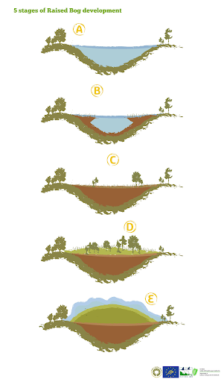
Formation of raised bogs
Raised bogs are mostly found in the midlands.
Began forming 10,000 years ago.
Started as shallow lakes.
Plants died and gathered at the bottom of the lake where the conditions were anaerobic, meaning the plants didn’t break down fully.
Dead plants built up over time and began to form peat, this eventually reached the surface.
Sedges began to grow turning it into a fen.
Raised bog species (e.g. sphagnum moss) invaded and the fen became a raised bog.

Slide 7
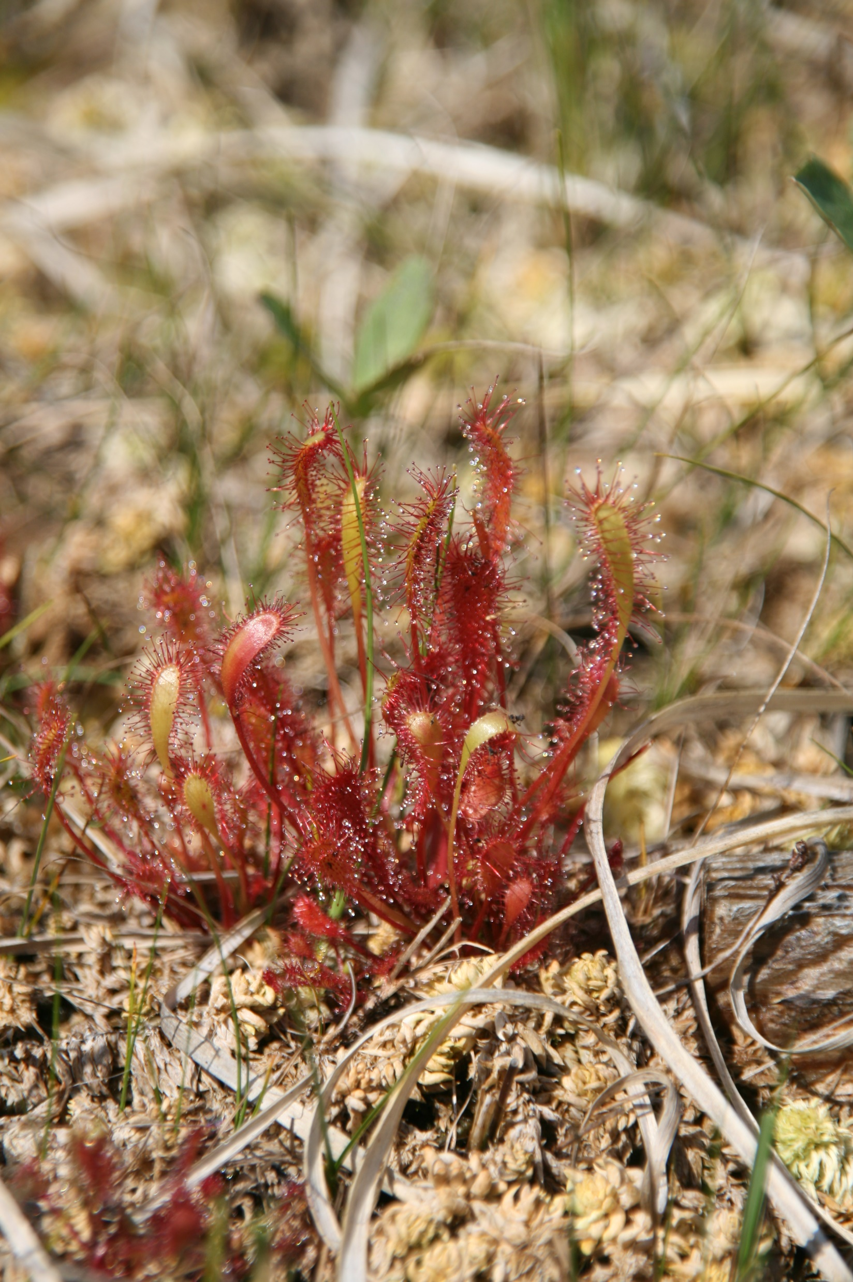
Why are they important?
Ireland has some of the best examples of raised bogs in Europe, but they are still in need of rescuing.
They are important for many reasons including biodiversity, water quality and carbon storage
Biodiversity: raised bogs contain plant species that are unique to them e.g. sphagnum moss, bog cotton, sundews.
Water quality: bogs can provide water storage and filtration.
Carbon storage: they act as a carbon store and control the level of greenhouse gases.

Slide 8
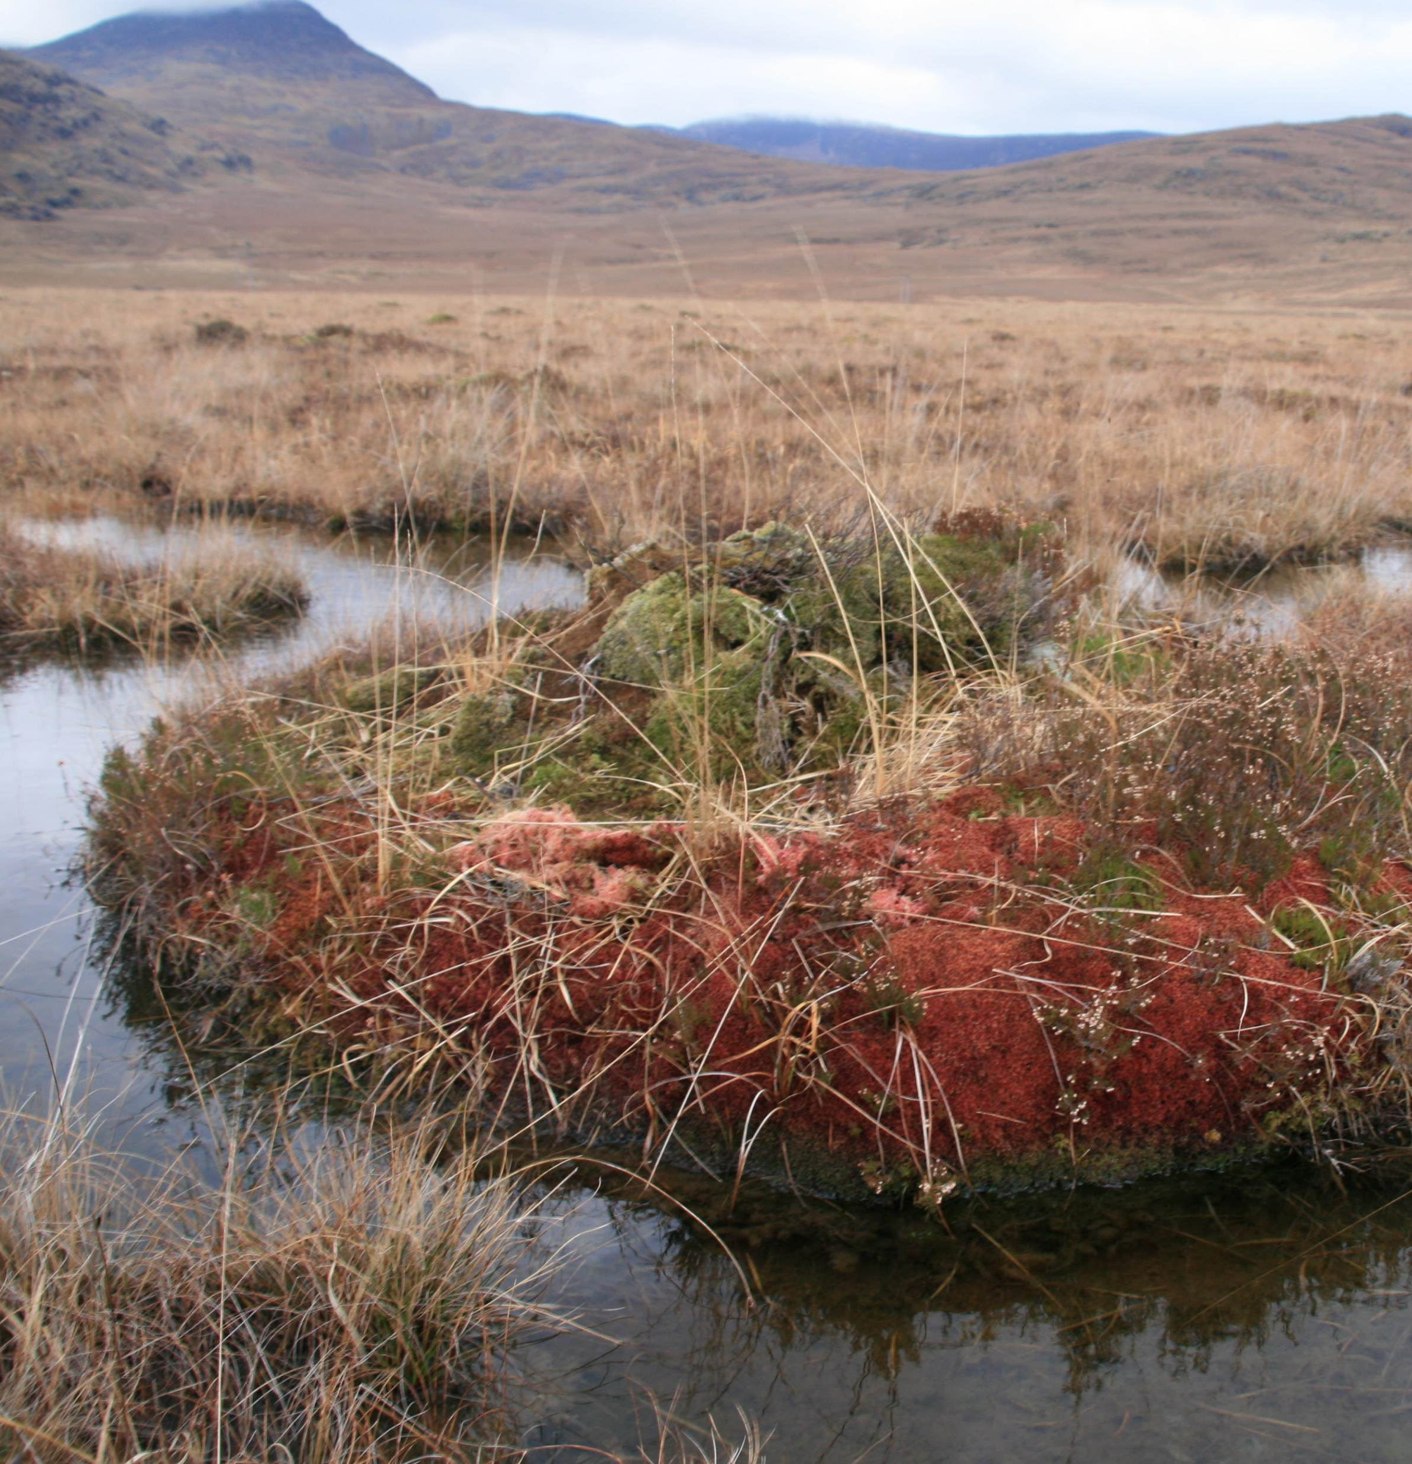
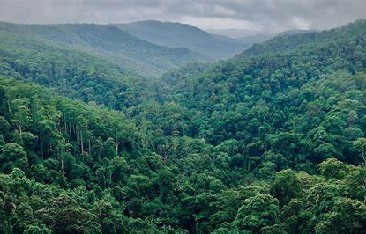
Carbon Stores
While raise bogs are meant to act as carbon storess, they are now becoming carbon sources. Meaning they will be releasing more carbon than they are storing.
One of the main driving factors in this release of carbon is drainage.
Up to 90% of the carbon lost from degraded bogs is exported via drainage.
The only practical solution to this is to stop the drainage and consider rewetting these raised bogs.

Slide 9
Carbon storage in the Amazon rainforest…

Slide 10
…versus Irish raised bogs

Slide 11
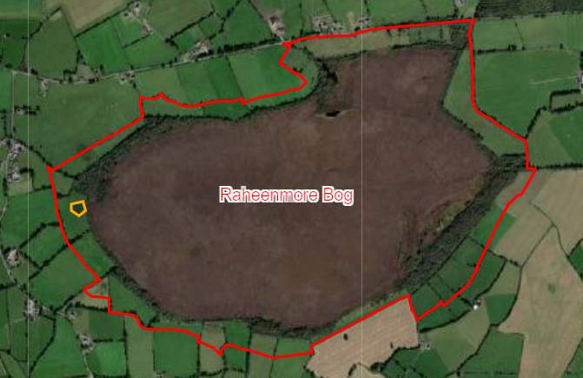
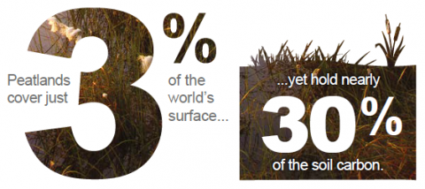
Transitional Habitats
All Irish Raised Bogs have lost the natural boundary with surrounding mineral soils i.e. the transitional zone.
These transitional zones have been drained and reclaimed to be used for agriculture.
This has had a number of negative effects on the peatland soils. Eg:
Decline in typical species in this area
High carbon emissions
Source of poor water quality
Habitat loss and disturbance
9 million tonnes of carbon are emitted by 330,000ha of grassland on peat soils

Slide 12
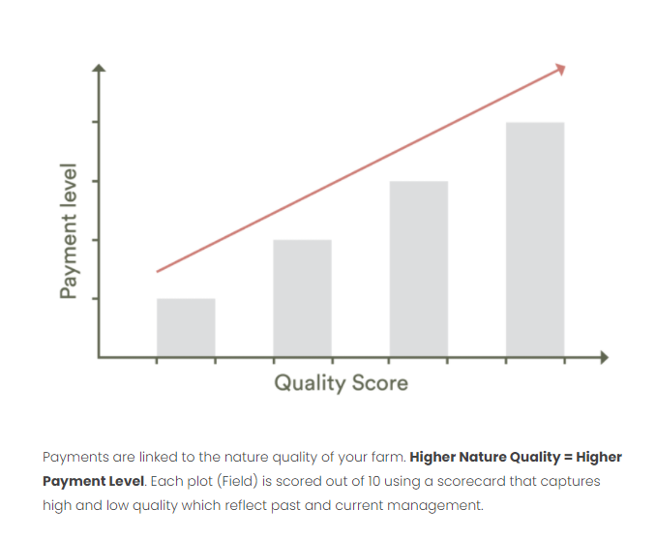
Results-based approach
Locally adapted, practical and results focused
Flexible and adaptive management on farm
Incentivise higher quality results
Proven to work (Hen Harrier Project, Pearl Mussel Project, BRIDE Project, Burren Programme).
Farmers are paid for what is already present on the farm.

Slide 13
Payment rates

Slide 14
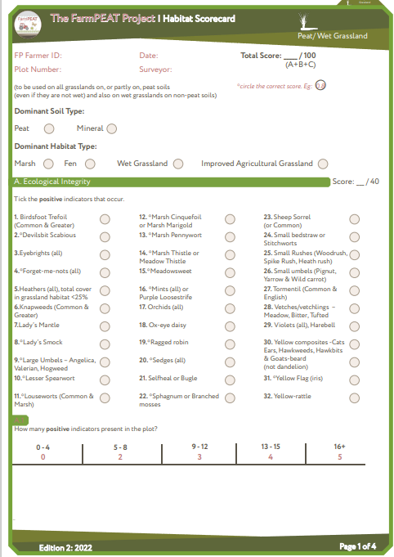
Scoring
Section one focuses on biodiversity. Points awarded for number of plant species present and their percentage cover. The higher the number and cover, the higher the payment (results-based).
Section two focuses on hydrological factor. Here, we look at drains on the farm and how they are affecting the peat soils and. A deep drain with a flow scores lower than a drain that has been blocked or where the flow has been impeded.
Section three focus on threats to site. Low scores are given where there is evidence of threats to the site.

Slide 15
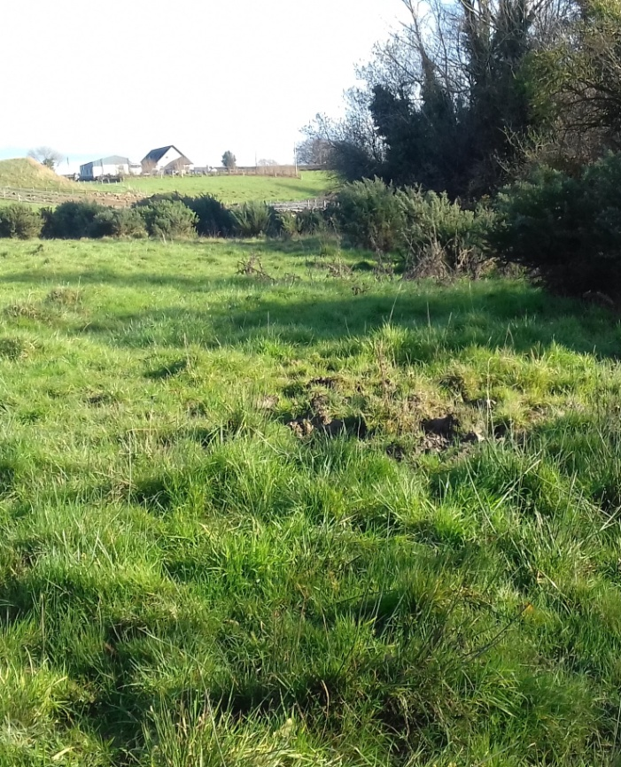
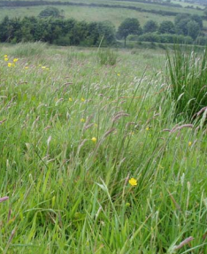
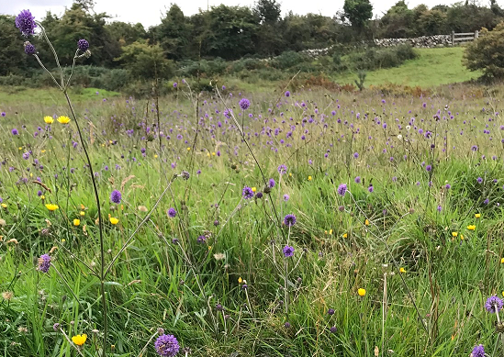
Examples of habitat quality in a wet grassland
Low quality
(Score 0-3)
€
Moderate quality
(Score 4-6)
€ € €
High quality
(Score 7-10)
€ € € €

Slide 17
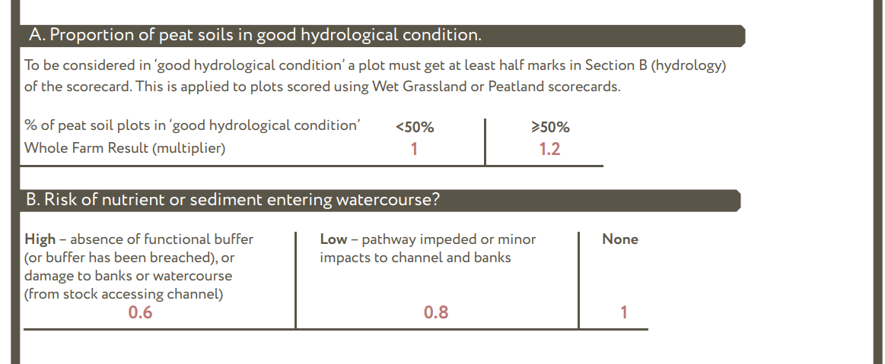
Whole Farm Assessment

Slide 18
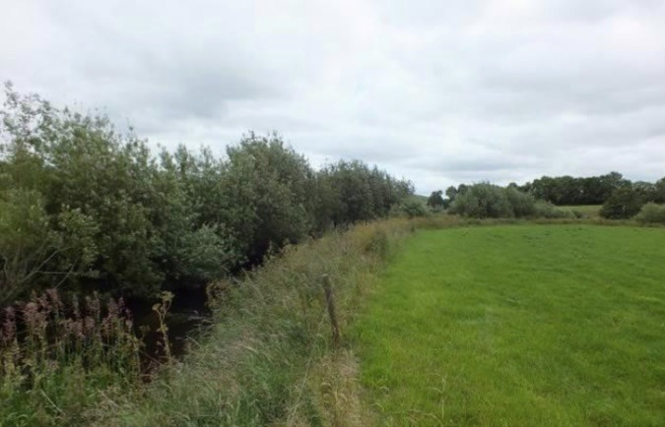
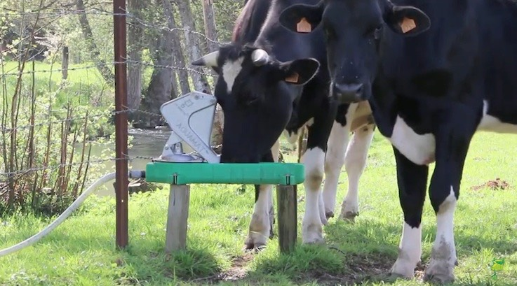
Supporting actions
Voluntary actions
Aim of increasing environmental quality
Increase in habitat score
Higher results-based payment
Can be used to improve WFA
Examples:
Drain management
Buffer zones
Fencing
Alternative feeding and drinking facilities

Slide 19
Annual Works Plan

Slide 20
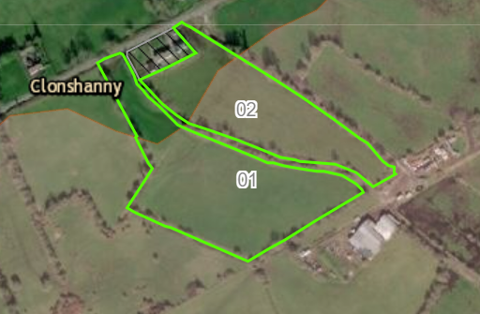
Rewetting actions
Bonus payment available
Payment based on 900/hectare
Possible impact on neighboring farms
Similar payment may be offered to them

