Slide 1
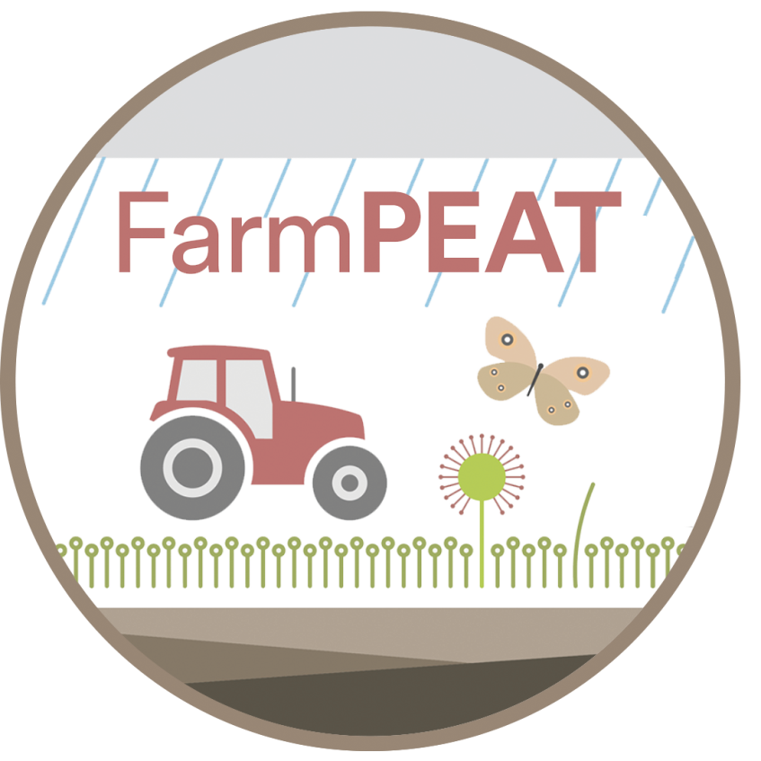
The Story of Ireland’s Raised Bogs
www.farmpeat.ie

Slide 2
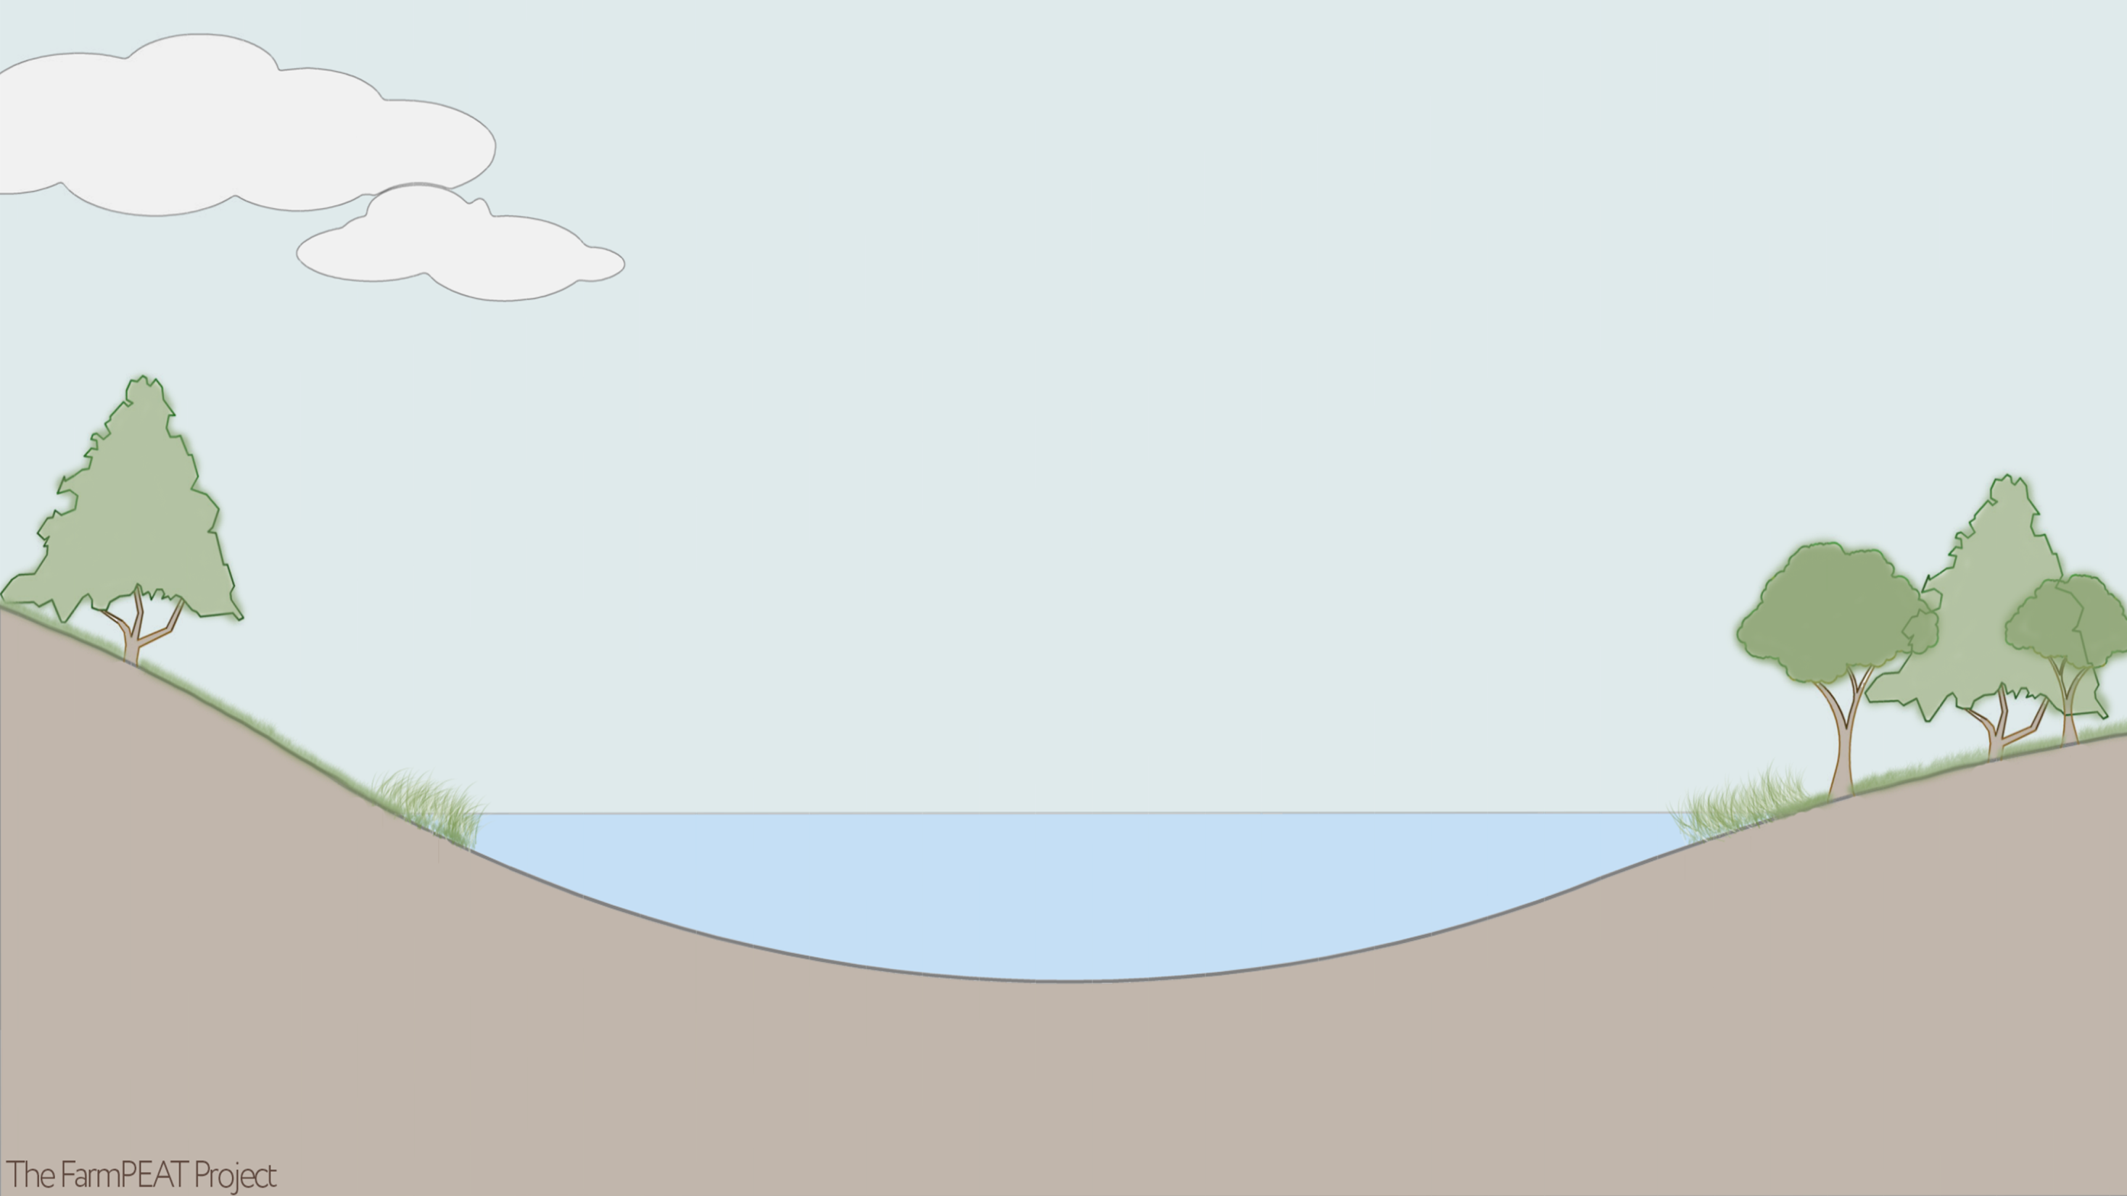
As glaciers melted across Ireland approximately 10,000 years ago, numerous shallow lakes remained across vast portions of the midlands of Ireland.

Slide 3
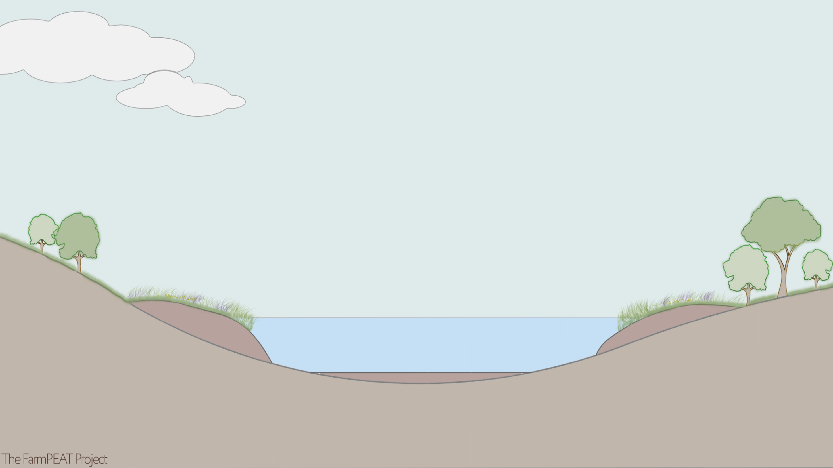
Gradually, plants growing around the margins of these lakes died. Their remains fell to the bottom of the lakes and partially decomposed, forming peat.

Slide 4
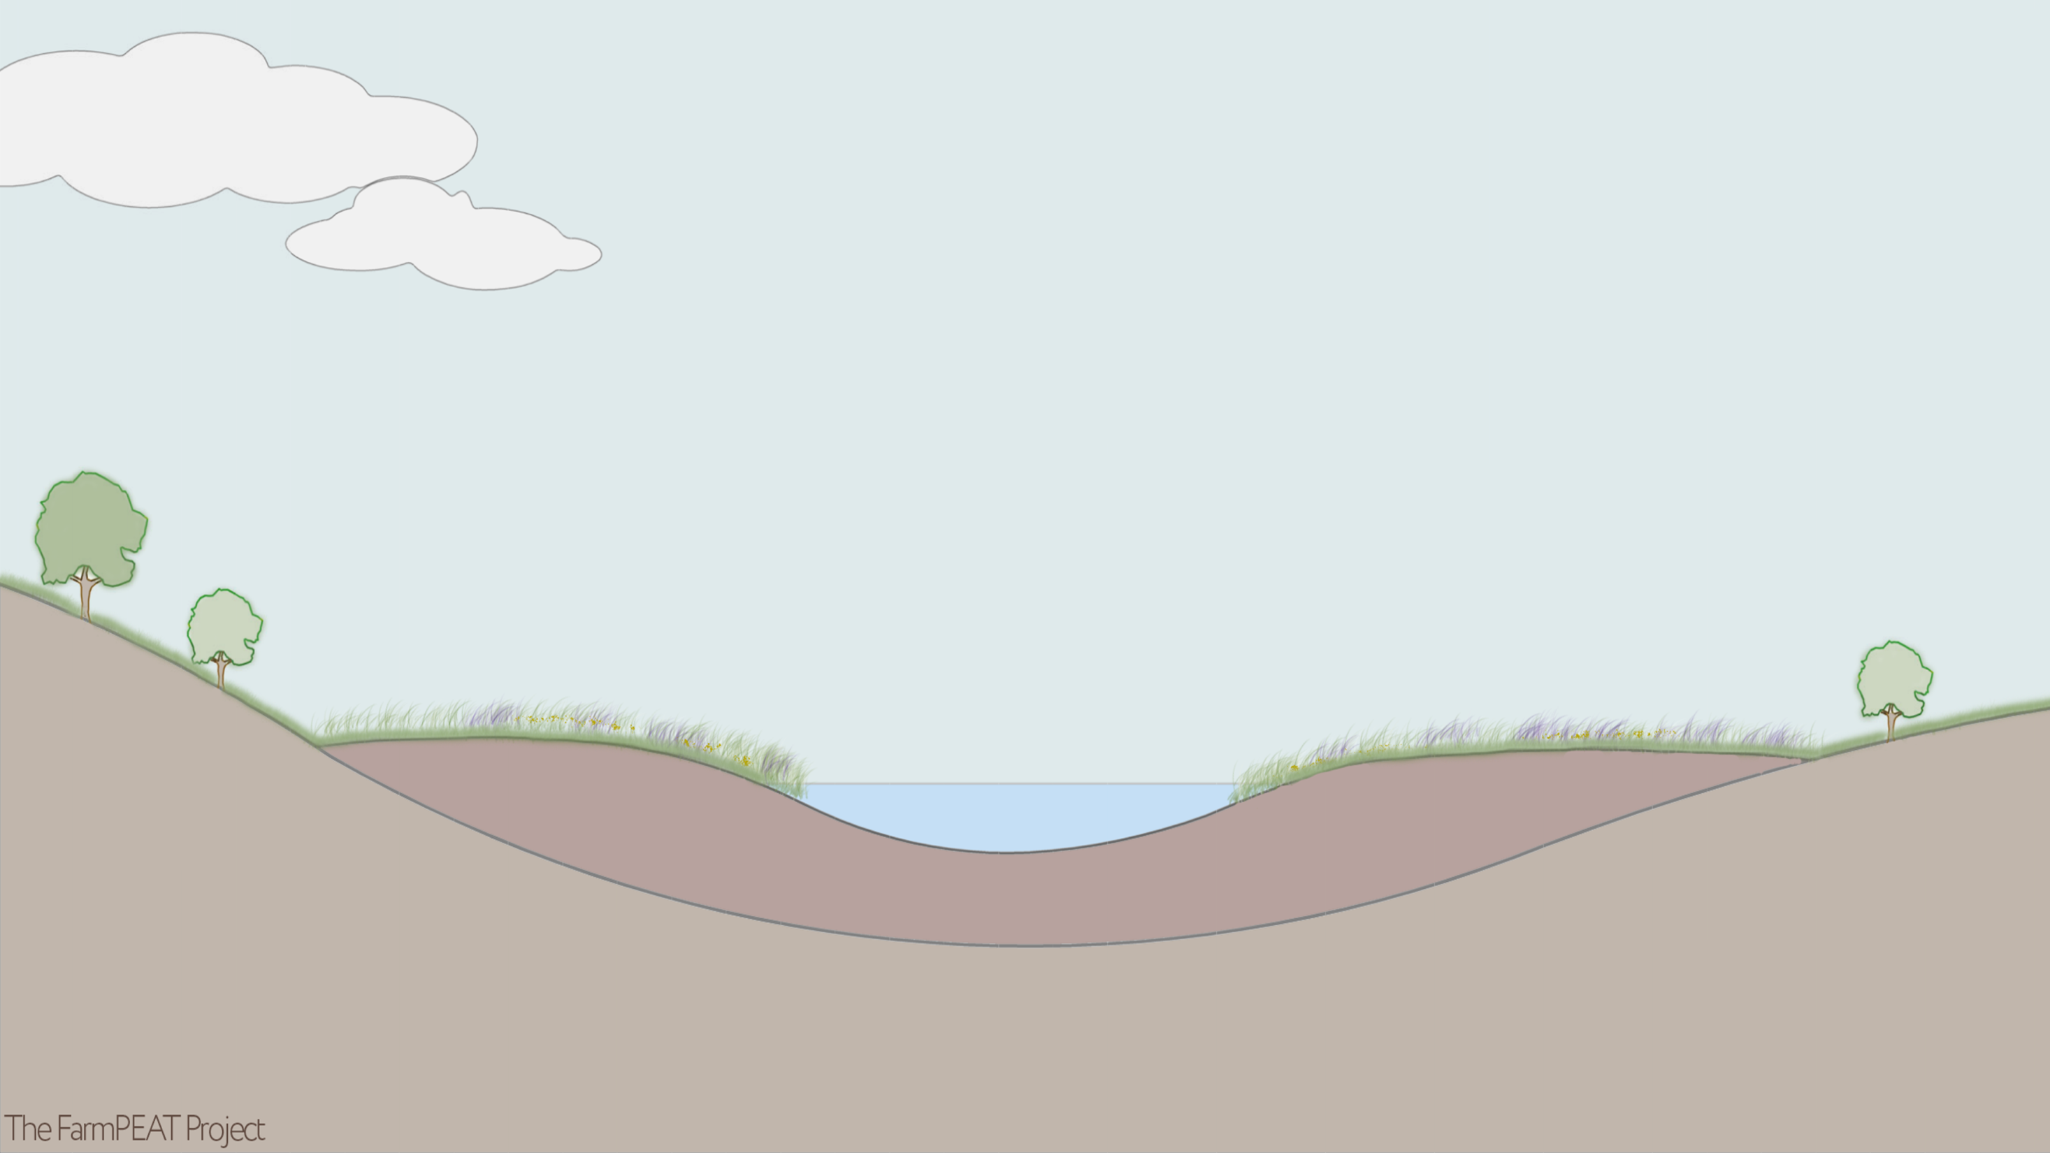
As the lake basins became almost fully infilled with peat, they formed what are known as fens. These fens were relatively nutrient rich.

Slide 5
Sphagnum mosses and other raised bog plants began to grow on the surface of the fens. These are the ‘bog builders’ – they made the habitat more acidic and formed more peat. They raised the bog surface above the surrounding land. Acidic raised bogs are naturally nutrient poor habitats and have a raised water table.
High bog surface and water level

Slide 6
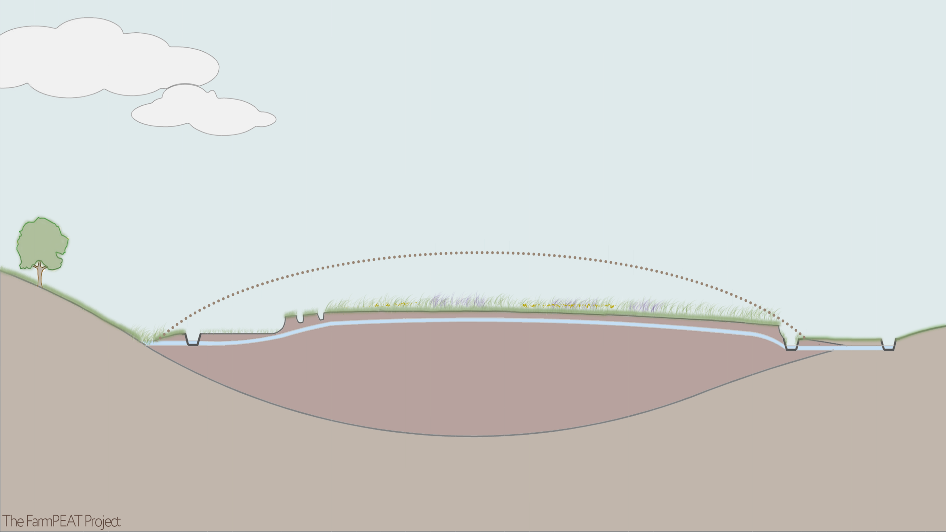
Humans viewed these nutrient-poor wetlands as ‘wastelands’. There is evidence that they started draining these habitats in the early 19th century. Industrial drainage and harvesting of peat in the 20th century further contributed to their demise. Once drained, the bog surface subsides and the water level drops.
Lower bog surface and water level
Drains

Slide 7
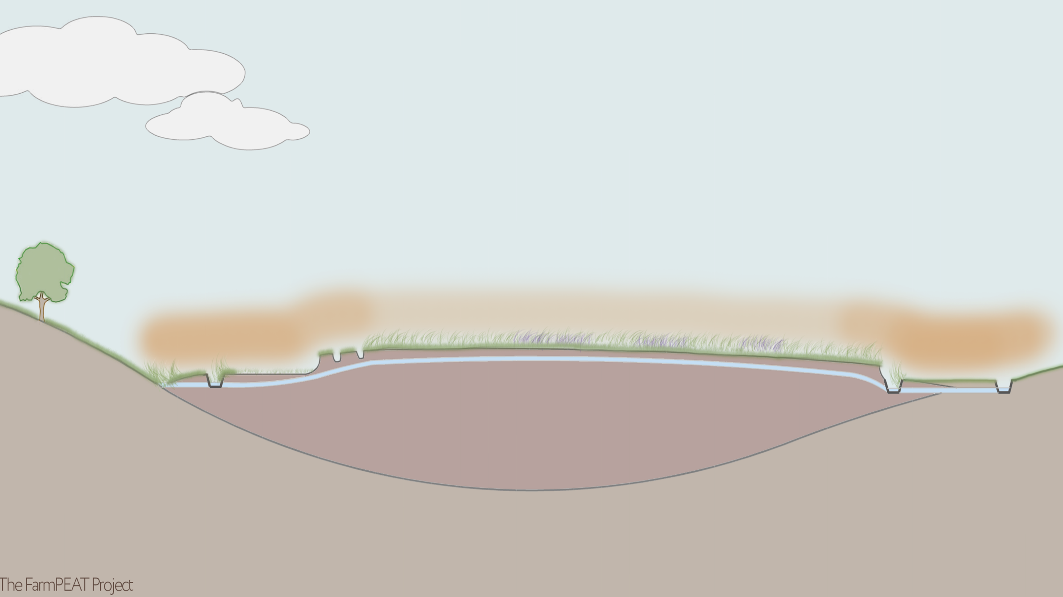
Drained raised bogs are sources of greenhouse gases. Peat is composed largely of carbon and when the peat dries out and is exposed to the air, decomposition rates increase. The carbon is then oxidised and released in the form of gases.

Slide 8
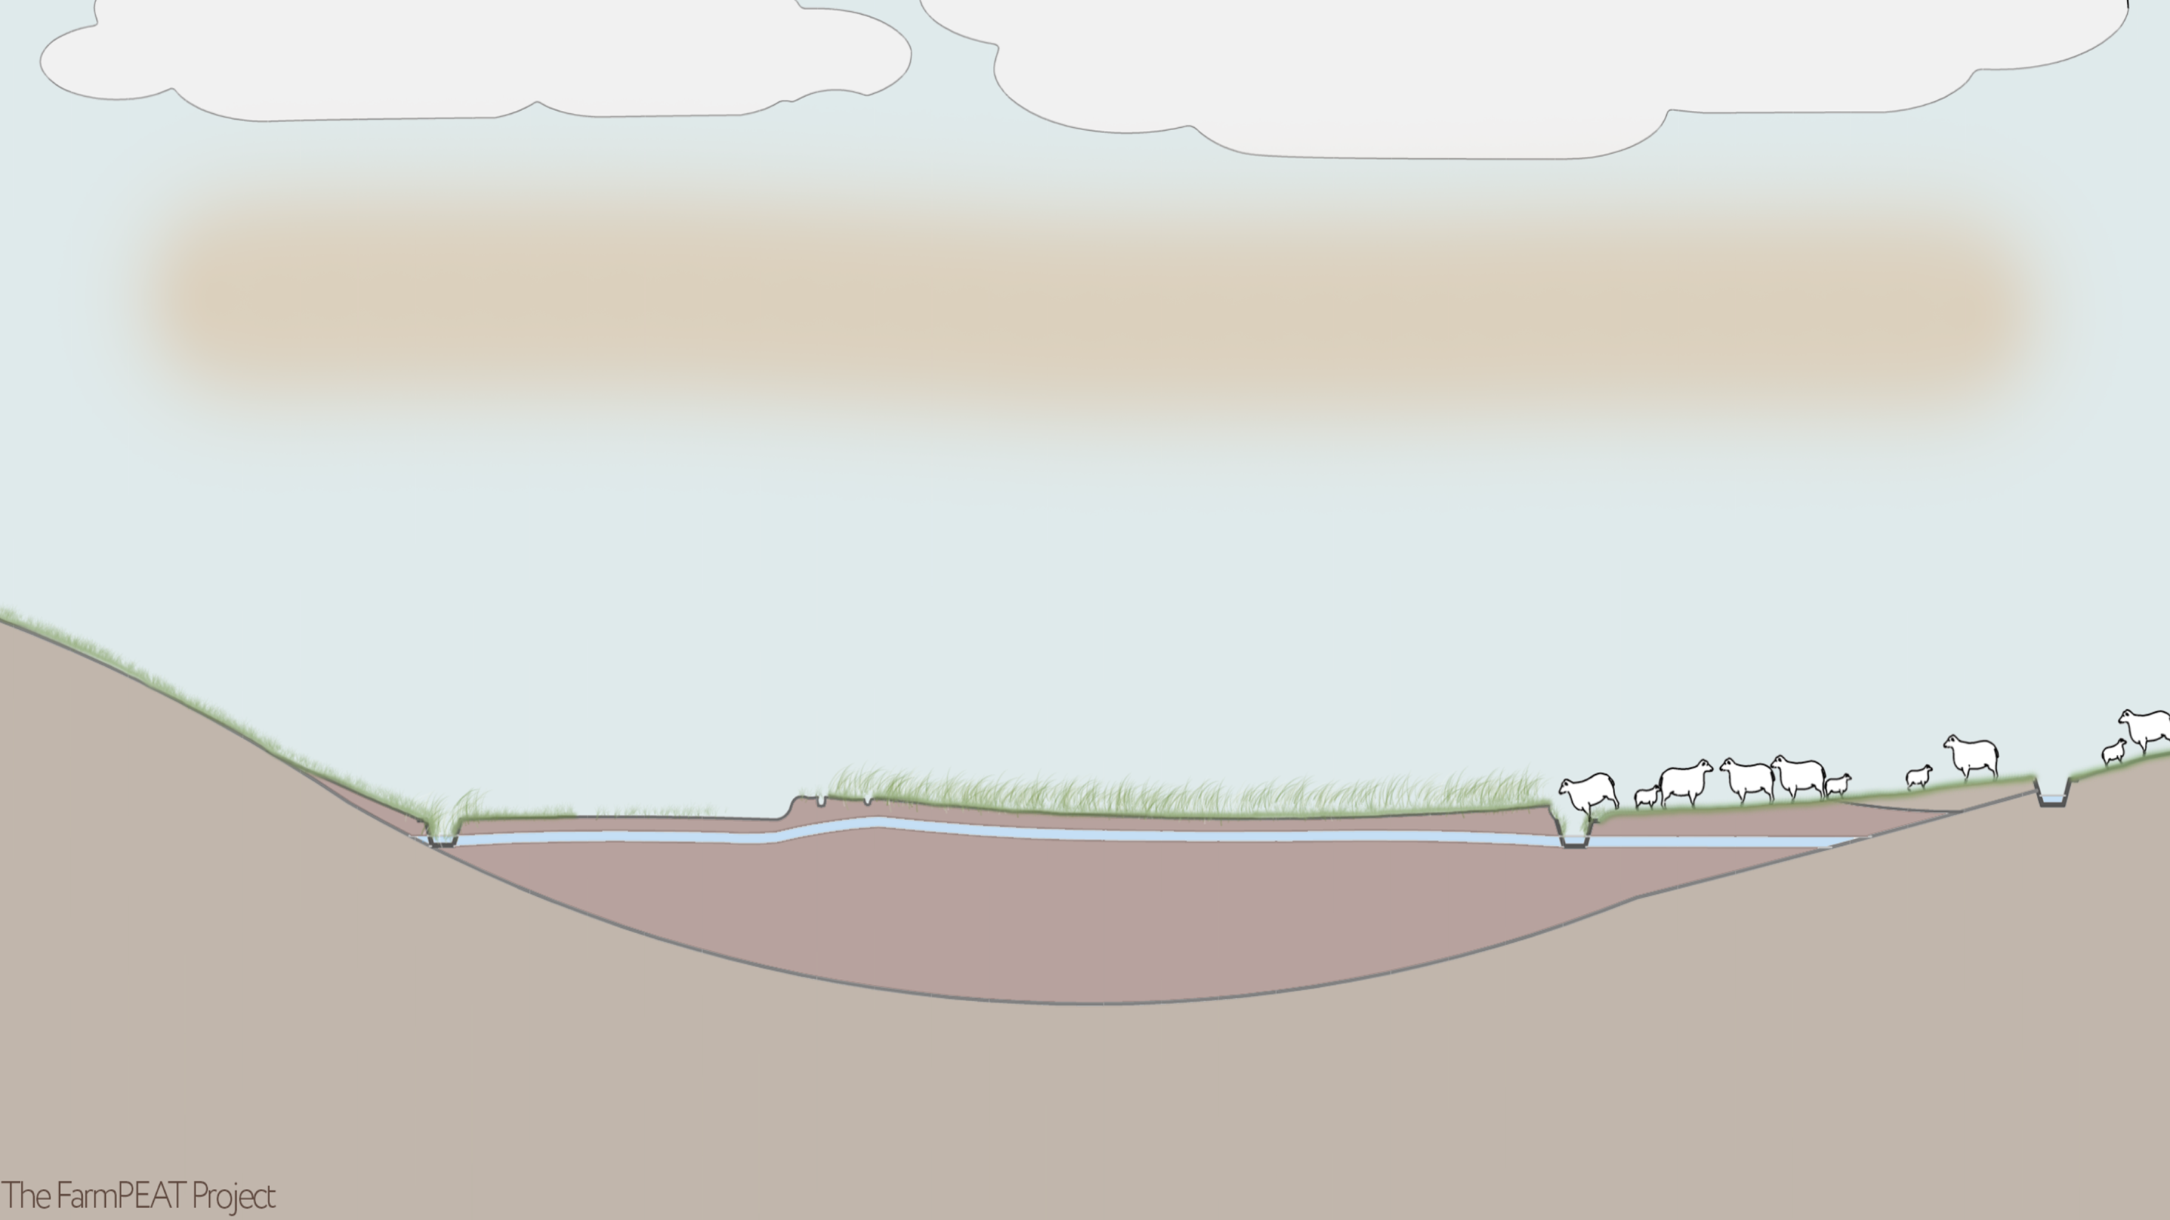
These drained agricultural grasslands on peat soils are sources of greenhouse gases that contribute to climate change.
In the midlands of Ireland, much of the land on the edges of the raised bogs was drained and reclaimed for agriculture.

Slide 9
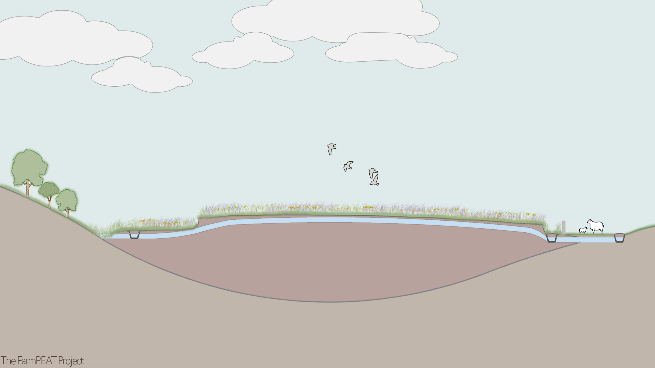
Installing dams to slow the flow of water in these peat soils helps in the fight against climate change. Keeping the peat wet reduces greenhouse gas emissions. There are also co-benefits for biodiversity and water quality!
Higher bog surface and water level

Slide 10
Learn More
www.farmpeat.ie/
www.ipcc.ie/
www.thepeatlands.ie/
www.npws.ie/peatlands-and-turf-cutting/peatlands-council/national-peatlands-strategy

